Slide 1
Atlantic Salmon Habitat Conservation

Slide 2
Atlantic Salmon Conservation Foundation
Thanks to generous funding from the
Atlantic Salmon Conservation Foundation
salmonconservation.ca

Slide 3
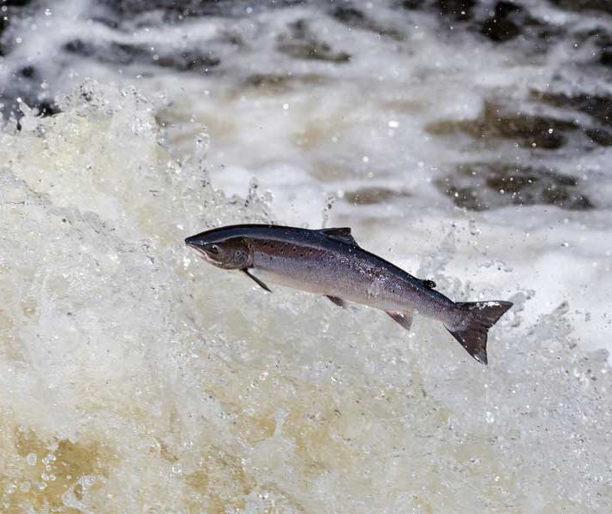
Atlantic Salmon
Notes:
Atlantic Salmon:
Anadromous fish
Born in freshwater, travel to saltwater and back to freshwater to lay their eggs
Adult Atlantic Salmon stop feeding once they reach freshwater
Return to their native stream to spawn
Life cycle is 3-8 years

Slide 4
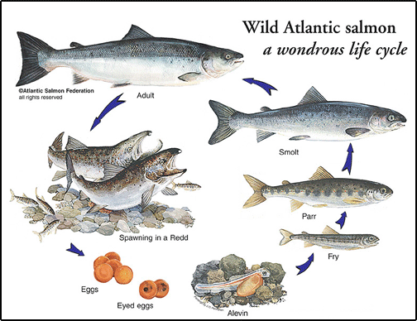
Atlantic Salmon Life Cycle
Notes:
Atlantic Salmon Life Cycle:
Born in a freshwater stream
Start as eggs - as they grow and develop, one of the first organs to develop are their eyes - the next stage is the eyed egg
Spend approximately 2-3 years in their native stream growing and developing:
First as alevin, with their yolk sacs still attached
When they have depleted their yolk sacs, they are called fry
As they grow larger, they grow vertical black bars on the sides of their bodies - this is the parr stage
Once the parr marks disappear, they are in the smolt stage, which are almost ready to go out to sea
Then they are adult salmon, ready to make the journey to the ocean
Spend approximately 1-2 years traveling to the ocean, and another 2-3 years at sea growing
Then they return to their native stream to spawn
They use their olfactory senses to find their native stream - like a built in map!
Atlantic salmon, unlike many species of salmon, do not die after spawning
The kelt (adults that have already spawned) can travel back to the Atlantic Ocean to feed and recover
If they survive, they will repeat the process again in the next few years

Slide 5
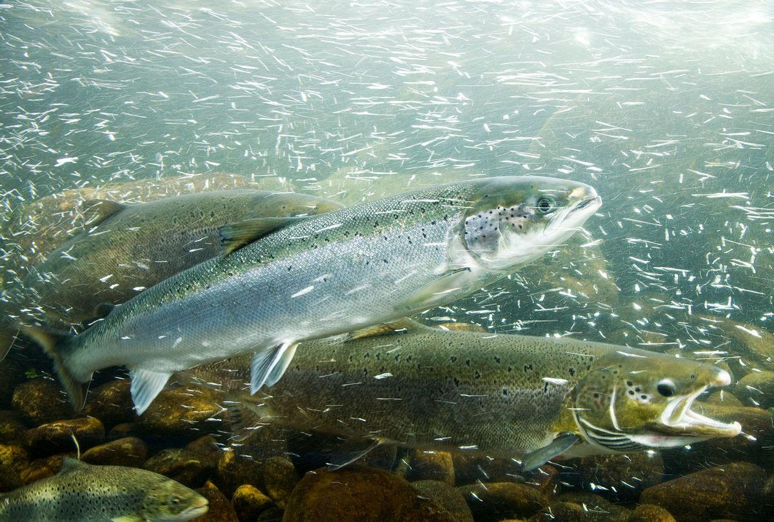
Reasons We Care About Atlantic Salmon
Cultural
Economical
Ecological

Slide 6
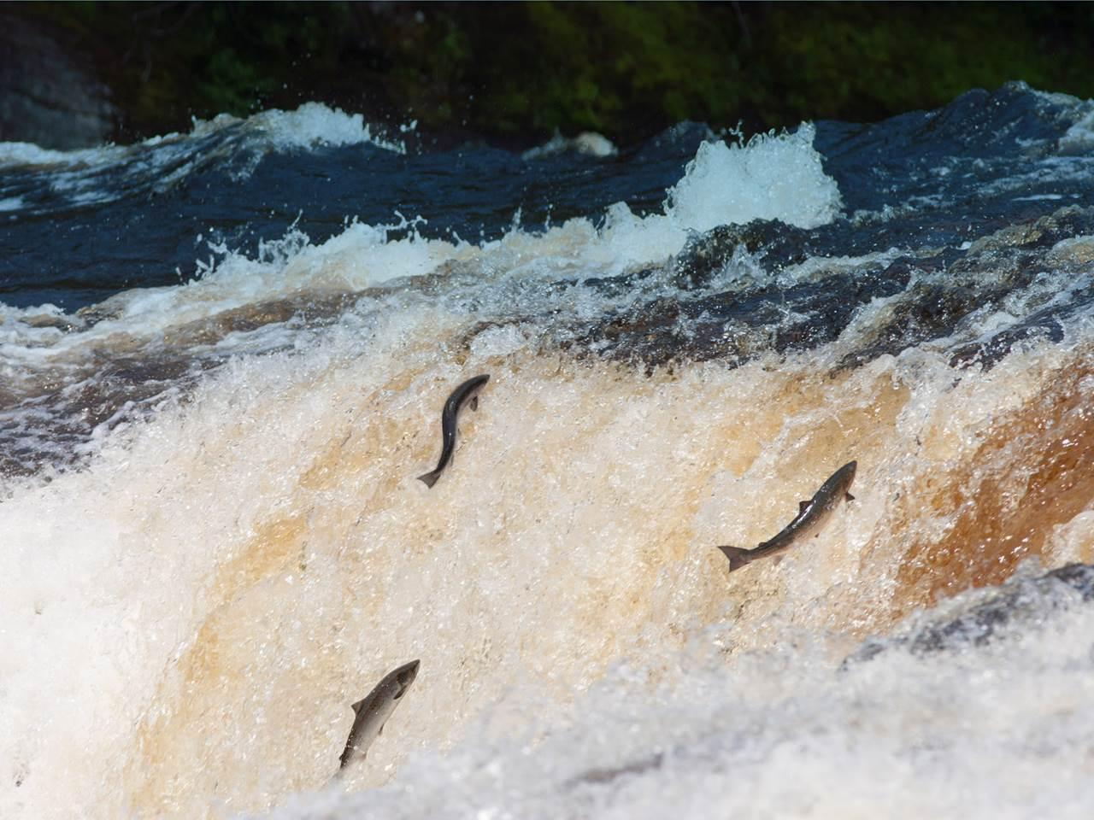
Cultural
Notes:
Cultural
Salmon are part of the spiritual and cultural identity of many people
Indigenous peoples celebrate the annual salmon return as it assures the renewal and continuation of human and all other life

Slide 7
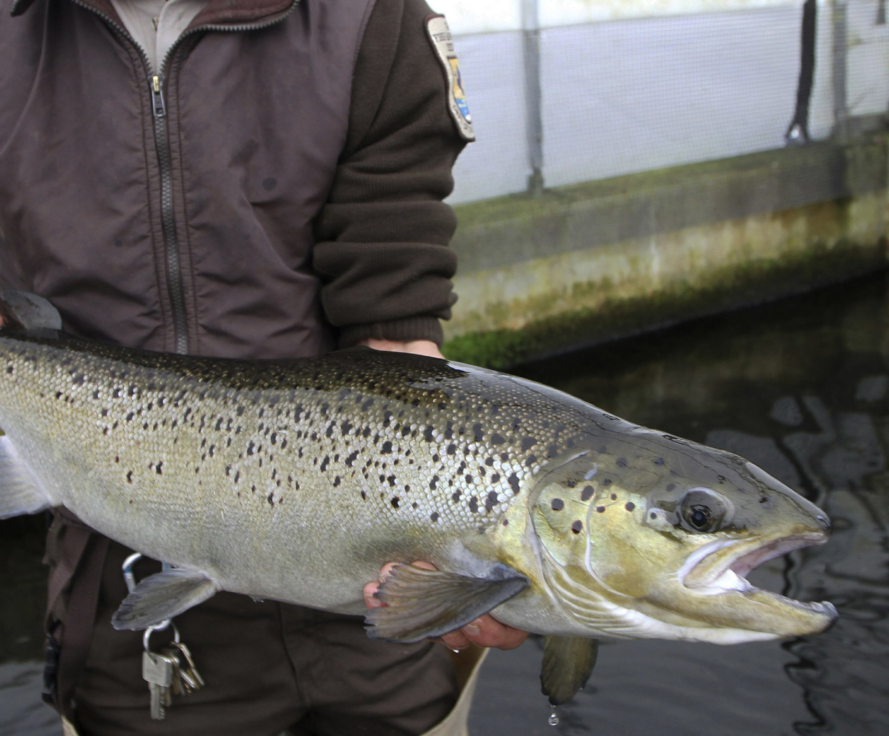
Economical
Notes:
Economical
Salmon contribute to the quality of life of many people, as both food and economic profit
Many communities also rely on salmon for tourism and attracting visitors to see and fish for the salmon

Slide 8
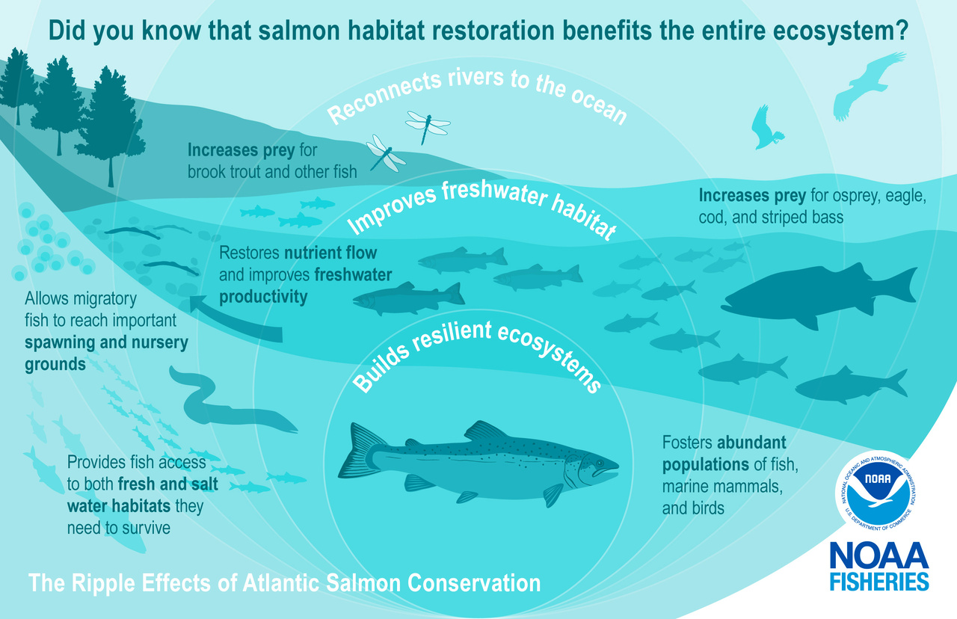
Ecological
Notes:
Ecologically
Salmon runs function as enormous pumps that push nutrients from the ocean to the headwaters of rivers of low productivity
Salmon are considered keystone species, meaning there are many species that rely on salmon, and they are very important in maintaining biodiversity

Slide 9
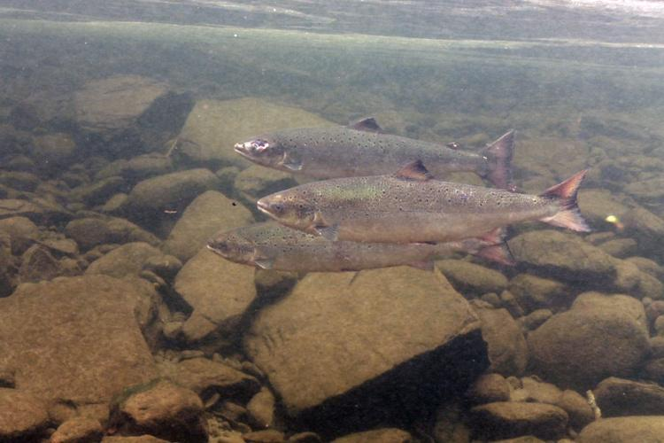
Salmon River Conservation
Notes:
Atlantic Salmon’s unique life cycle means that they rely on good river habitats
Protecting their habitat is crucial to helping support this species
What we do on land affects what happens in the water, which is why it is important to protect the riparian buffer surrounding their habitat
This is what SAM is working with community’s on…

Slide 10
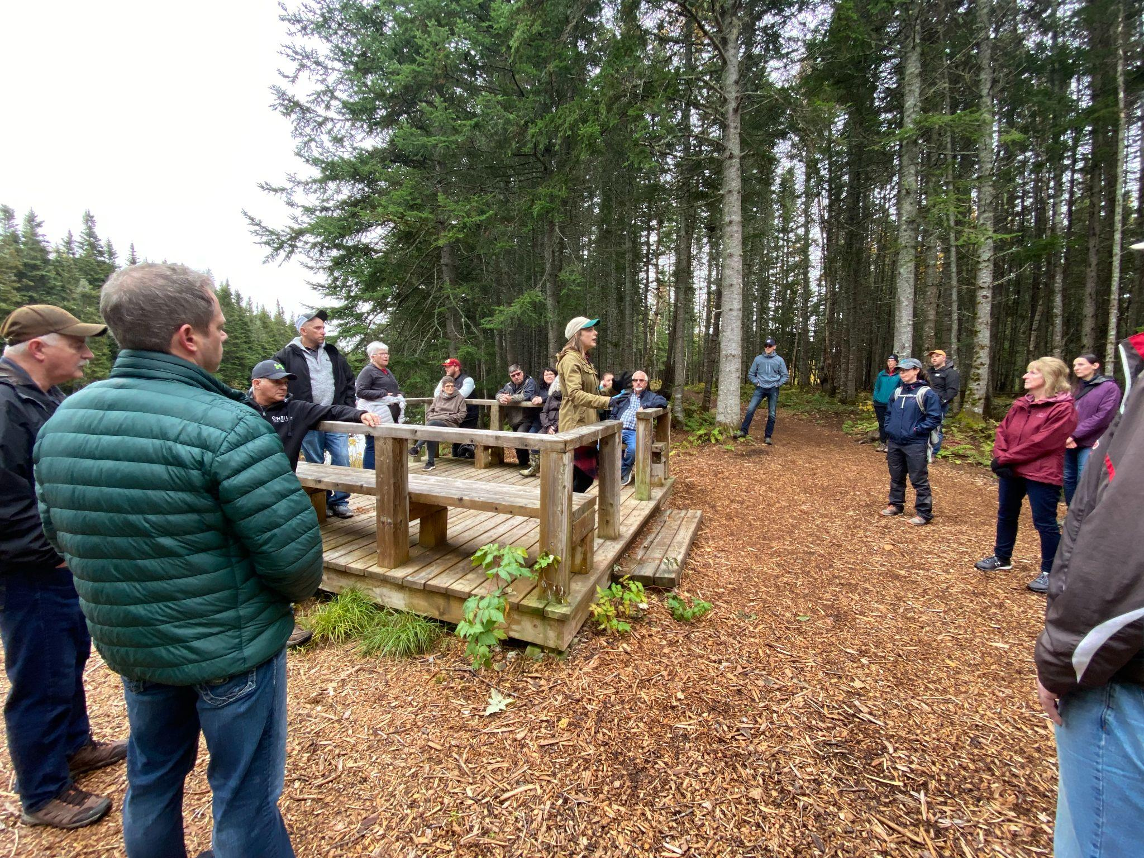
SAM and Salmon River Conservation
Notes:
SAM is working with communities to:
Protect riparian buffers of salmon rivers
Participate in education and outreach programs
Encourage best practices for resource users
Supporting local initiatives in salmon conservation

Slide 11
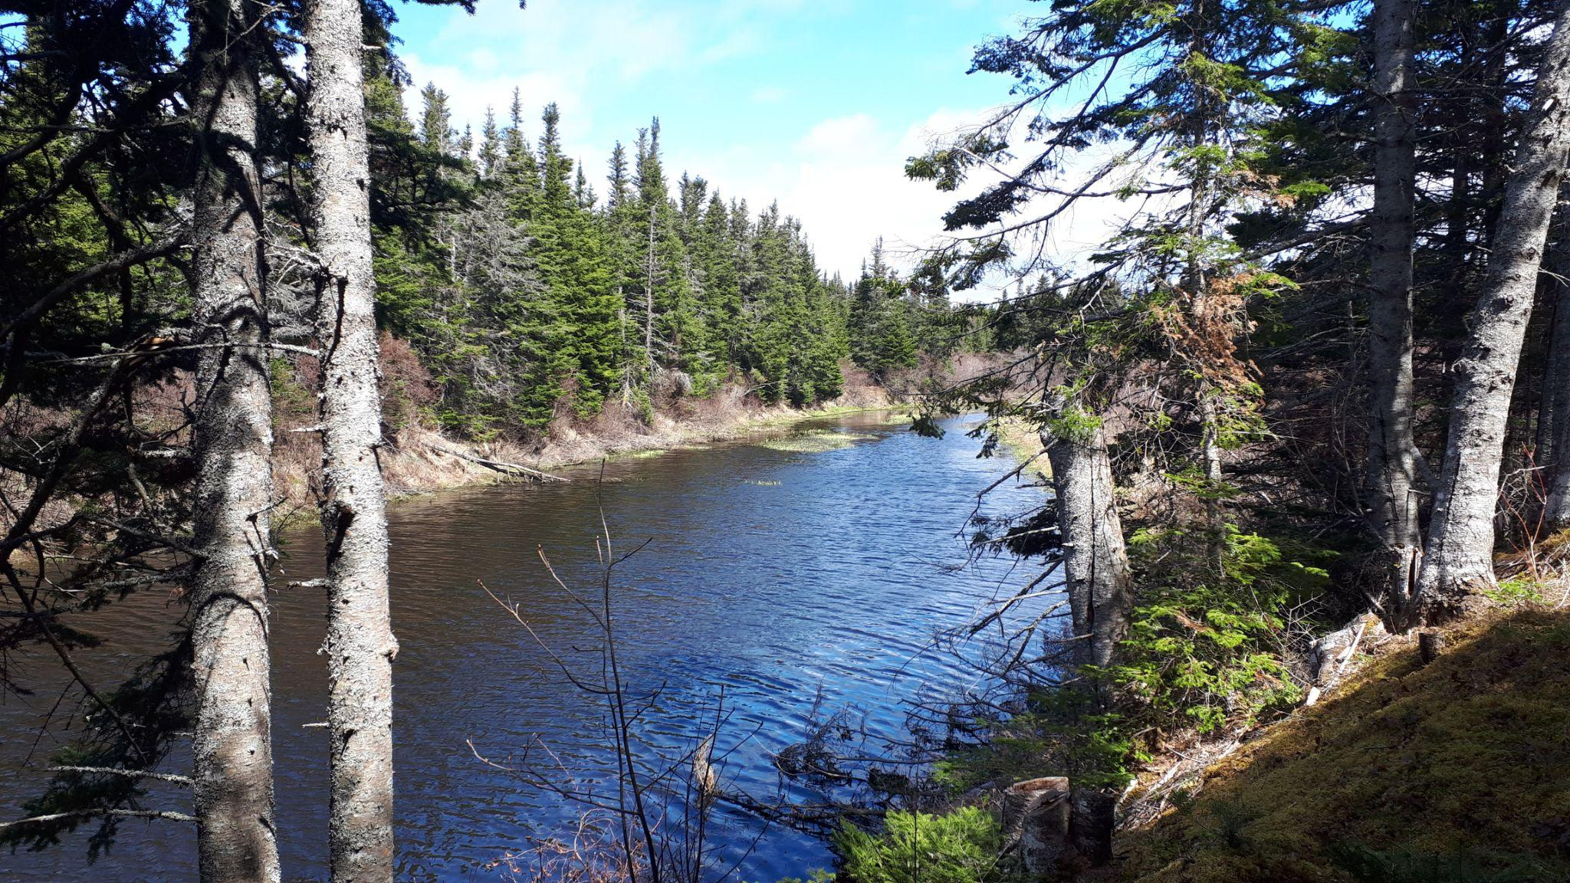
What is a Riparian Buffer?
Notes:
Edges of ponds or rivers which serve as important habitat for a large diversity of wildlife
Natural vegetation from the edge of the stream bank out through the riparian zone which serves as a buffer to pollutants entering a stream from runoff, controls erosion, and provides habitat and nutrient input into the stream
Riparian buffers are key to maintaining the health of rivers
Lands Act requires a 15 metre buffer on all waterways in NL

Slide 12
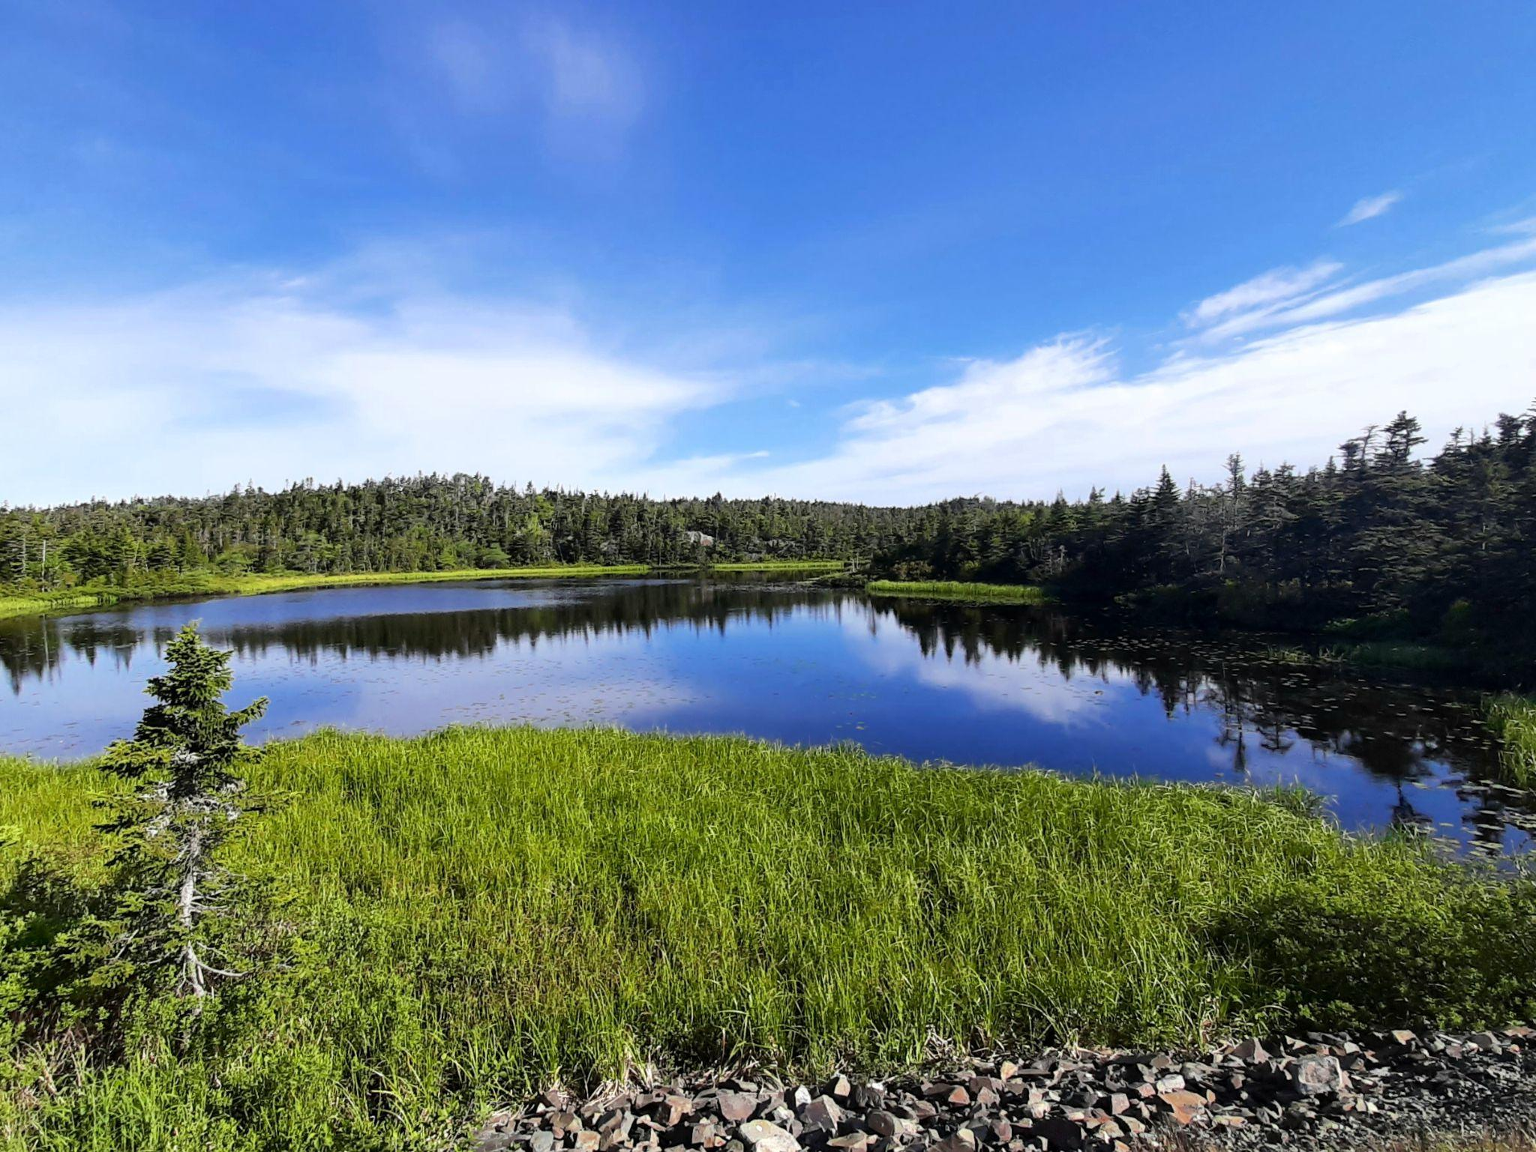
Why Maintain a Healthy
Riparian Buffer?
Notes:
Increased biodiversity
Nursery for fish and waterfowl
Filter and clean our water (including some heavy metals)
Stores carbon and help mitigate climate change
Reduces the effects of erosion and decreases siltation into freshwater habitats
Improved air quality
Mitigate flood risks
Promotes growth of native plant species which reduces invasive species
Helps native pollinator and invertebrate populations
Natural privacy screen
Shields against noise pollution
Acts as a windbreak against snow and blowing winds

Slide 13
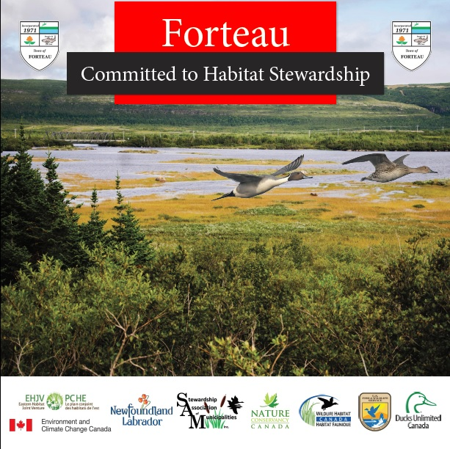
Municipal Agreements
Notes:
SAM encourages member communities to sign agreements protecting their salmon rivers, and encourage them to:
encourage best practice for salmon angling in their communities
advocate for and enforce proper maintenance of riparian buffers
when appropriate, restore buffers and shorelines

Slide 14
Questions?
Karleena Squires
Outreach Coordinator
Stewardship Association of Municipalities
www.samnl.org
samengagement995@gmail.com

