Slide 1
Limestone Barrens
Programming Created by:
Karleena Squires
Outreach Coordinator
John E. Maunder

Slide 2
What are the Limestone Barrens?
John E. Maunder
Notes:
What are the Limestone Barrens?
-An extensive area on the island’s North/Western coast comprised of patches and slivers of unforested land
-They are underlain by both limestone and dolomite bedrock
-Lacking trees, the limestone barrens are a hotspot of floral diversity
-The barrens are home to over 100 rare species, contributing to Newfoundland and Labrador’s rich biodiversity
-The encroachment of the boreal forest is kept at bay, in part, by the repeated disturbance caused by the dynamics of the freezing and thawing cycle and the icy winds
-The limestone, a geographical remnant of tropical times and marine animal deposits, provides a unique substrate compared with the acidic boreal forest soils. Paired with the extreme weather, it breeds both endemism and rarity

Slide 3
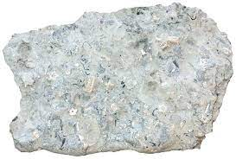
What is Limestone?
Sedimentary rock composed mainly of calcium carbonate and usually has a rich fossil content
Notes:
What is Limestone?
-Sedimentary rock composed mainly of calcium carbonate and usually has a rich fossil content

Slide 4
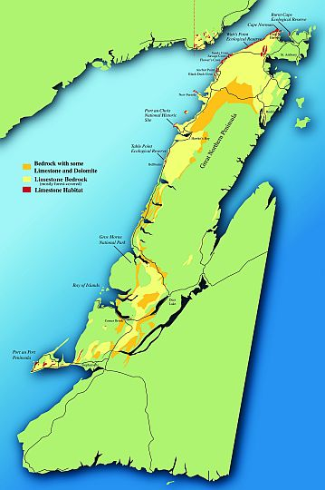
Limestone Barrens Regions
}
Northern
Notes:
Limestone Barrens Regions
-Northern:
-Roughly 200 km along the extreme western and northwestern margins of the Northern Peninsula, from Bellburns to the Burnt Cape Ecological Reserve

Slide 5
Limestone Barrens Regions
Southern
}
Notes:
Limestone Barrens Regions
-Southern:
-Comprising the summit of Table Mountain, west of Stephenville, and several exposed sections of the nearby Port au Port Peninsula
-Numerous, additional, smaller, coastal cliffs, outcrops, bare patches, and marls of limestone and/or dolomite, of varying geological age, occur primarily in the western and central portions of the Island, on Belle Isle, in the Strait of Belle Isle region of southern Labrador, and in central and northern Labrador
-Although not quite worthy of the grander name "limestone barrens", these smaller occurrences nevertheless support many extremely important elements of the overall "limestone flora and fauna" of Newfoundland and Labrador.

Slide 6
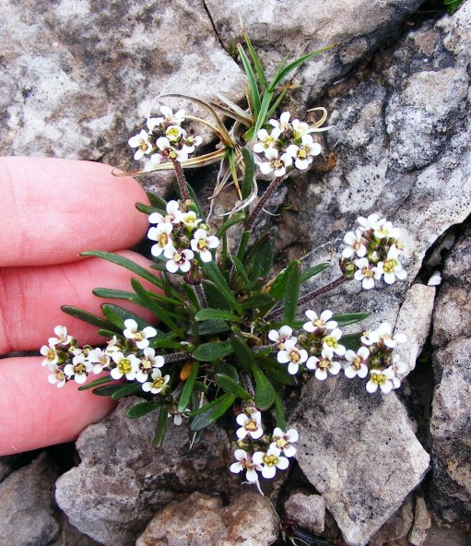
Challenging Environment
Limestone Soils
Barren Habitat
Frost Action
Proximity to Human Habitation
Climate Change
D. Pelley
Notes:
Challenging Environment
-Our limestone barrens present many challenges to their plant and animal inhabitants:
-Limestone Soils:
-The flora is largely limited to species that are adapted to the chemistry of calcareous soils.
-Barren Habitat:
-The flora is generally exposed to damaging and drying winds, and must survive in poor rocky soils that are often overly-well drained and unstable.
-Frost Action:
-The soils of our limestone barrens are subjected to dramatic cycles of freezing and thawing, that greatly disturb the soil, and present unique challenges.
-Proximity to Human Habitation:
-Most of the barrens are located within, or very close to, human habitation. As a result, the flora and fauna is constantly under the threat of damage or complete destruction by everyday human use of their habitat.
-Climate Change:
-The limestone barrens of NL occupy a very restricted area. Thus, most of the limestone organisms that live there are quite rare. The worry is that climate warming may both diminish the already small size of our barrens (through natural reforestation), and cause cold-loving arctic and alpine species at the limit of their ranges here to perish from our shores.

Slide 7
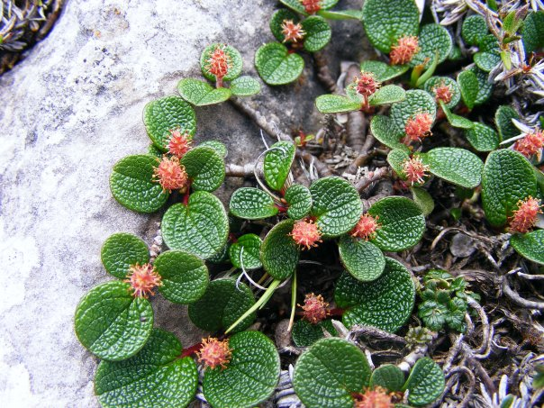
Flora
What are “Limestone Plants”?
Notes:
Flora of the Limestone Barrens
-"Calcicole" (limestone-loving) plants grow mainly on basic (high pH) soils rich in calcium carbonate (CaCO3)
-"Calcifuge" (limestone-avoiding) plants grow mainly on acidic (low pH) soils
-"Soil indifferent" plants "just don't care". They grow on soils of varying acidity
-It's all about chemistry!
-Flora of the Limestone Barrens fall into 5 categories:

Slide 8
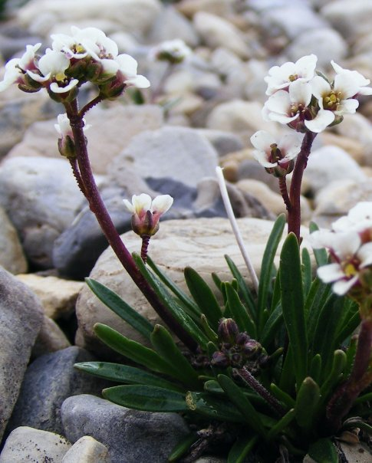
Flora
Newfoundland Endemic
“Limestone-Loving”
Long’s Braya
Barrens Willow
Fernald’s Braya
Notes:
Flora of the Limestone Barrens
-Newfoundland Endemic “Limestone Loving” - species found only in Newfoundland
-Long’s Braya: A member of the mustard family. It is very small, only growing to a height of 1 - 10 cm. Long's braya is similar to Fernald's braya except for its pouch, which is hairless. Its petals are also larger, and its seed pods are not quite as purple. This plant is endemic to the northwest coast of the Great Northern Peninsula. Long's braya is a self-pollinating plant.
-Barrens Willow: The barrens willow belongs to the willow family. It is a dwarfish shrub with red-brown stems and hairless branchlets. This plant species is endemic to the Great Northern Peninsula, ie. it grows only here and nowhere else in the world.
-Fernald’s Braya: Fernald's braya is a member of the mustard family. It is very small, growing to a height of 1 - 7 centimeters. It is endemic to the northwest coast of the Northern Peninsula. Fernald's braya is a self-pollinating, perennial plant which lives for several years in ideal growing conditions.

Slide 9
Flora
Gulf of St. Lawrence Endemic
“Limestone-Loving”
St. Lawrence Primrose
Newfoundland Pussytoes
Longleaf Arnica
Notes:
Flora of the Limestone Barrens
-Gulf of St. Lawrence Endemic “Limestone-Loving” - Species found only in the Gulf of St. Lawrence region (which includes the Newfoundland west coast and Strait of Belle Isle):
-St. Lawrence Primrose
-Newfoundland Pussytoes
-Longleaf Arnica

Slide 10
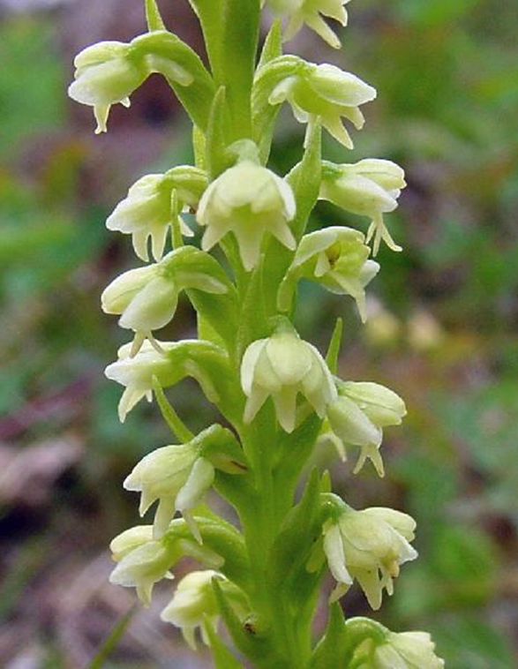
Flora
Disjunct “Limestone-Loving”
Newfoundland Orchid
Dwarf Hawk’s Beard
Woolly Arnica
Pendantpod Oxytrope
Bodin’s Milkvetch
Notes:
Flora of the Limestone Barrens
-Disjunct “Limestone-Loving” - Species found both in some far-away place, and in our area, with a big gap in between (think Europe/Antarctica)
-Newfoundland Orchid
-Dwarf Hawk’s Beard
-Woolly Arnica (endangered provincially)
-Pendantpod Oxytrope
-Bodin’s Milkvetch (threatened provincially)

Slide 11
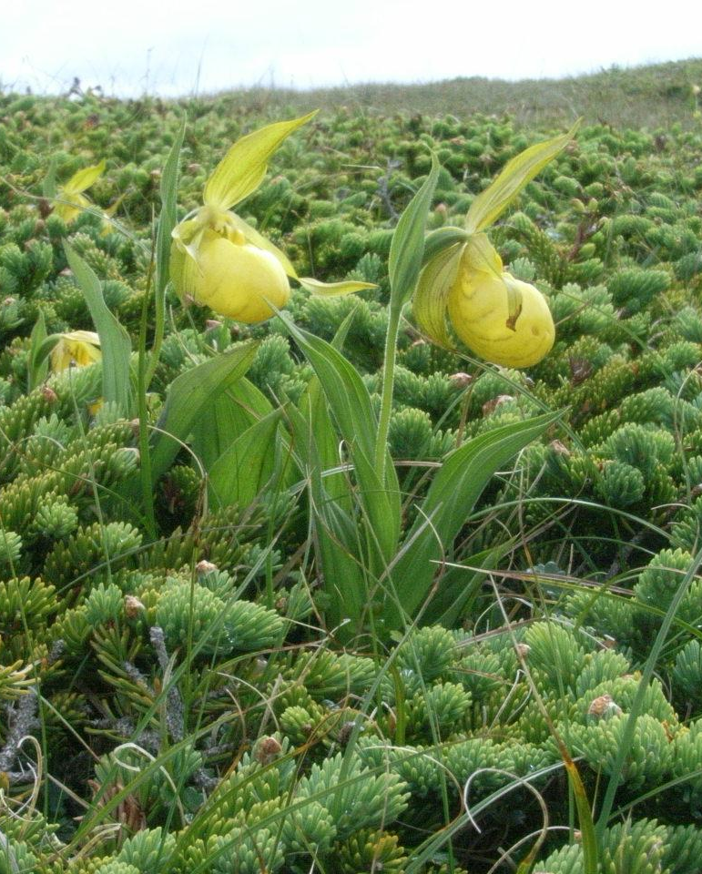
Flora
More Widespread “Limestone-Loving”
Yellow Ladyslipper
Calypso Orchid
Small Roundleaf Orchid
Purple Mountain Saxifrage
Island Gentian
Notes:
Flora of the Limestone Barrens
-More Widespread “Limestone-Loving” - species found in different places around the world
-Yellow Ladyslipper
-Calypso Orchid
-Small Roundleaf Orchid
-Purple Mountain Saxifrage
-Island Gentian

Slide 12
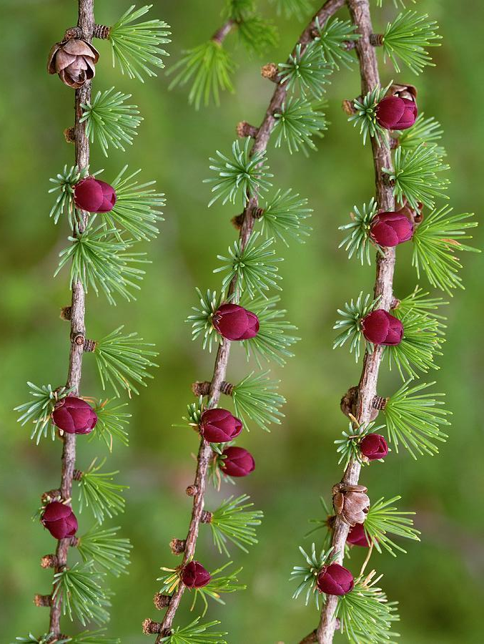
Flora
Widespread Species which are not “Limestone-Loving”
Larch
White Spruce
Black Spruce
Notes:
Flora of the Limestone Barrens
-Widespread Species which are not “Limestone Loving” - species that will grow anywhere
-Larch
-White Spruce
-Black Spruce

Slide 13
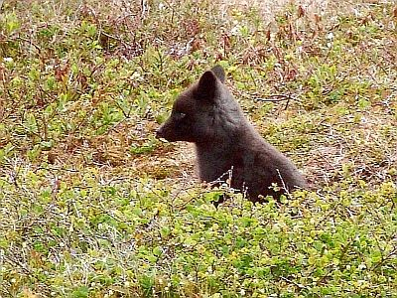
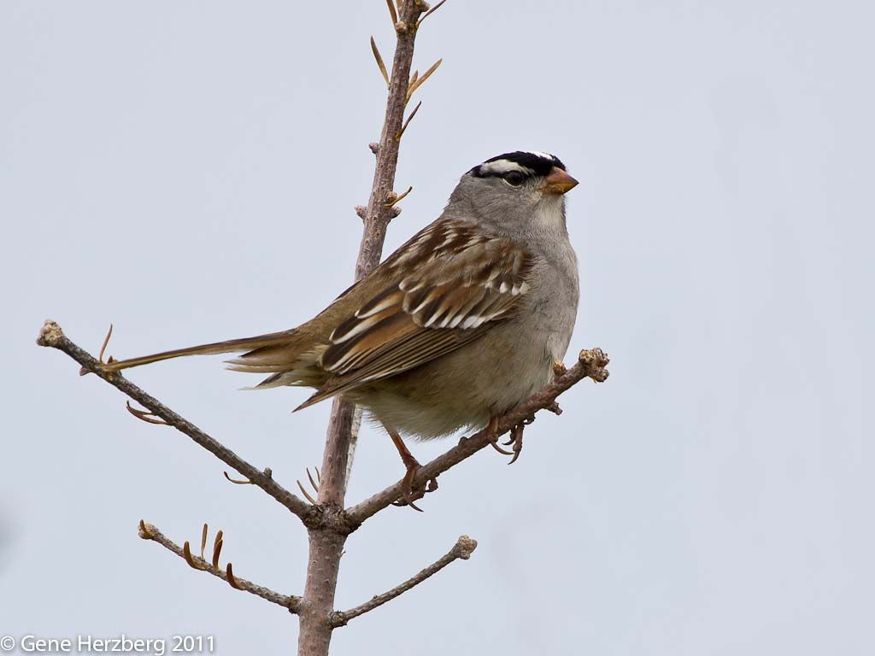
Fauna
John E. Maunder
Gene Herzberg
Bex Ross
David Reed
Notes:
Fauna of the Limestone Barrens:
-No mammals/birds are known to be restricted to "limestone" habitats, although many inhabit such areas
-Mammals such as foxes are known to frequent the area
-The White-crowned sparrow is a ubiquitous species of the Great Northern Peninsula, and the Labrador coast
-Short eared owls (provincially threatened species) are not nearly as common as they used to be - before major gravel-pitting in the Strait of Belle Isle seriously degraded much of the coastal "limestone barrens" habitat
The insect/arachnid fauna of our "limestone regions" is not well known, but:
-Diamond Back moths are closely-associated with our endemic "limestone barrens" Braya species
-In 2003, Anne Marie Hynes collected 77 species of spiders on Burnt Cape
-In 2010, Pickavance and Dondale described a brand NEW spider species, Iviella newfoundlandensis, from Point Riche, Table Point, Eddies Cove East, and Burnt Cape.
Others:
-By rough count, about 30 terrestrial molluscs (snails and slugs) and about 20 freshwater molluscs (snails and clams) reside in our "limestone regions".

Slide 14
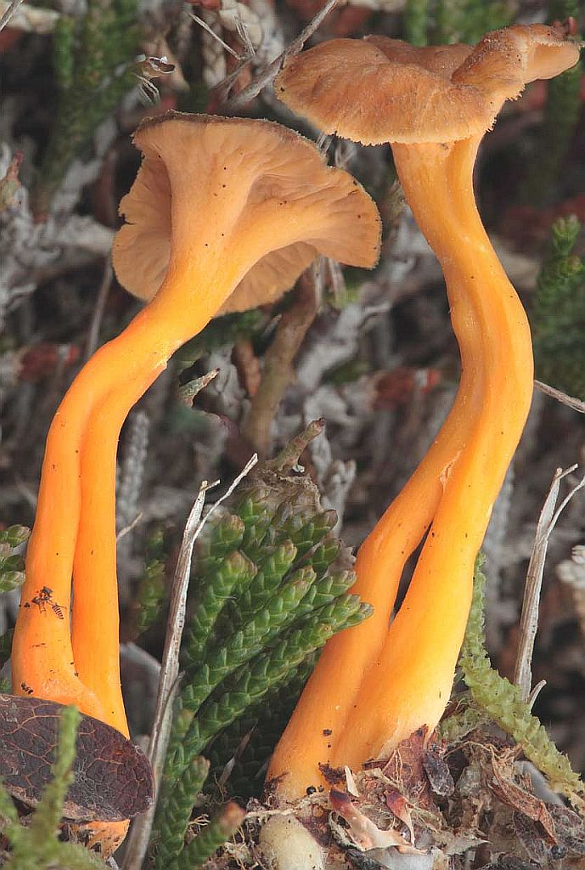
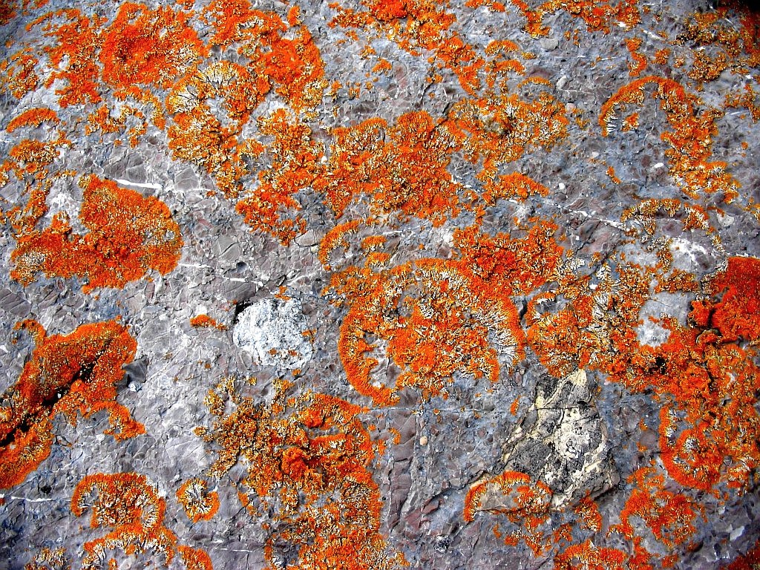
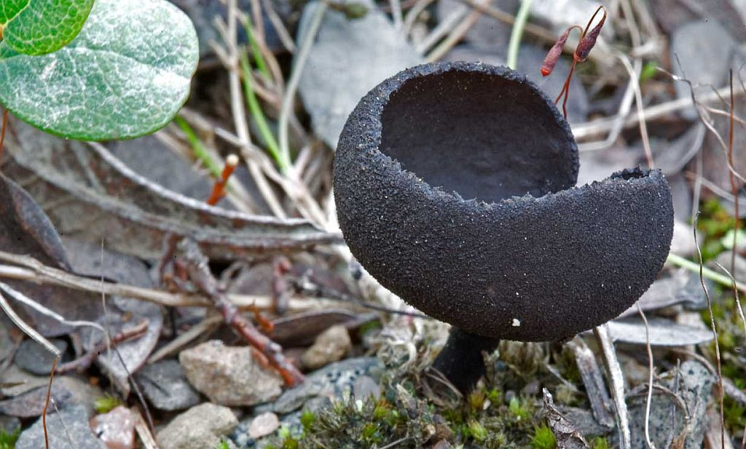
Fungi & Lichen
Andrus Voitk
Pat/Dan Montague
Andrus Voitk
Notes:
Fungi & Lichen of the Limestone Barrens:
-We still have very little understanding of the fungi of our "Limestone Barrens" - however, during the course of the 2010 Mushroom Foray, one day was spent collecting on Burnt Cape, and a list of 31 fungus species was compiled.
-Some interesting species found include Yellow-foot Chanterelle, and Elfin Saddle
-One interesting thing about fungi is that it is an important degrader of limestone minerals, thus contributing to the long-term erosion of "limestone" bedrock and gravels.
-James Lendemer of the New York Botanical Garden collected 374 lichen samples on the limestone barrens
-The species of lichen that inhabit "limestone" substrates are mostly completely different from those that inhabit siliceous substrates (ie. granites or schists) such as this Sunburst Lichen

Slide 15
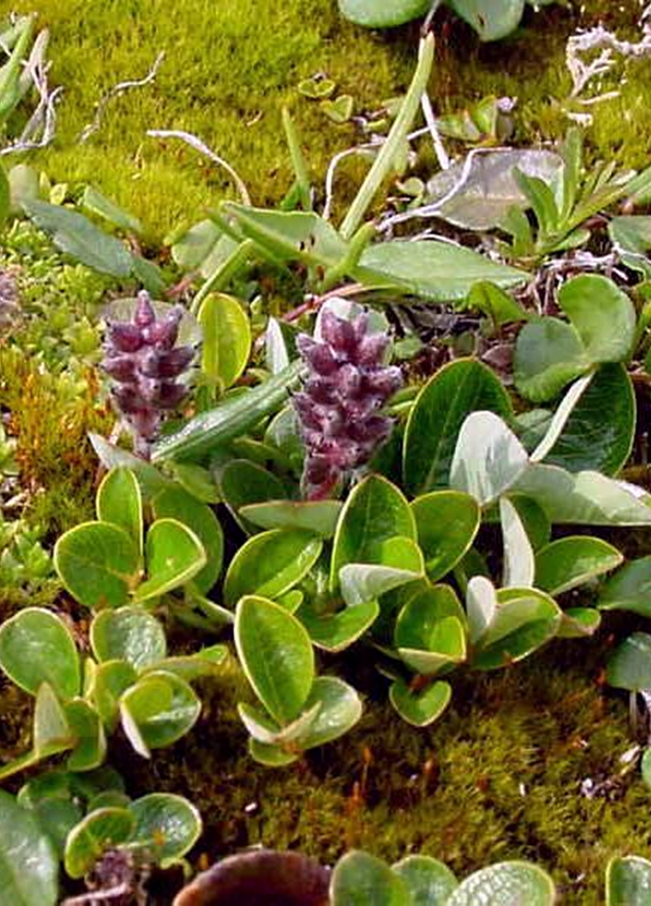
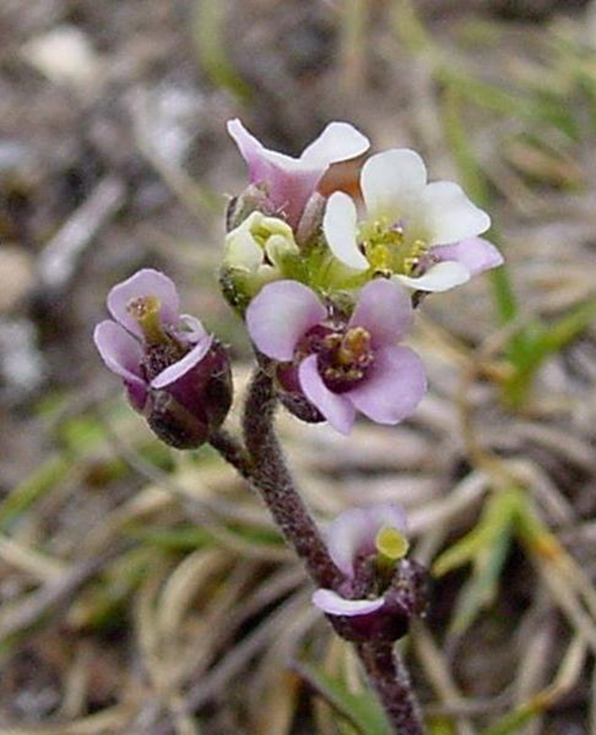
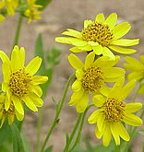
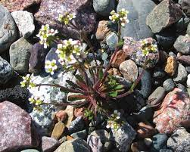
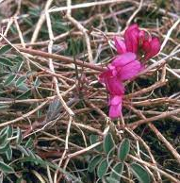
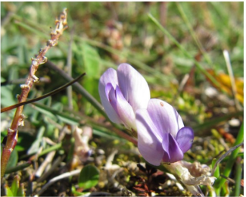
Species at Risk in the Barrens
Long’s Braya
Barrens Willow
Fernald’s Braya
Wooly Arnica
Low Northern Rockcress
Mackenzie’s Sweetvetch
Bodin’s Sweetvetch
Notes:
Species at Risk in the Limestone Barrens:
-Limestone Barrens plants presently on the Provincial Endangered Species Act include:
-Endangered:
-Long's Braya*
-Barrens Willow*
-Fernald's Braya*
-Wooly Arnica
-Low Northern Rockcress
-Threatened:
-Mackenzie's Sweetvetch
-Bodin’s Milkvetch
*Also included in the Federal Species at Risk Act (SARA) - at risk NATIONALLY

Slide 16
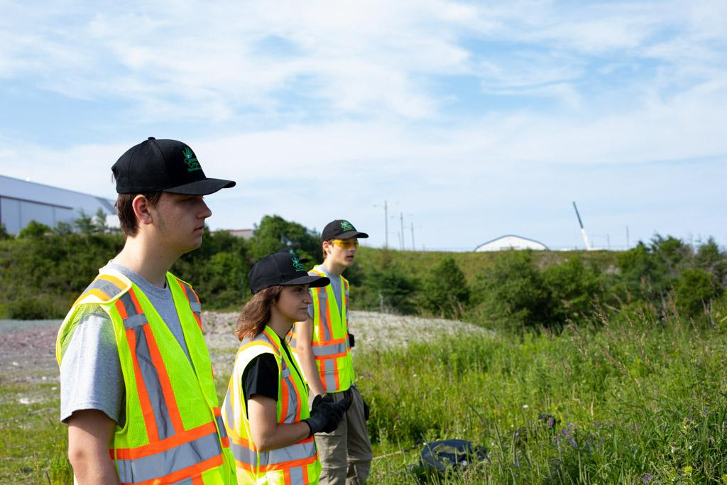
Stewardship
Conservation and care of environmental resources for present and future generations
Notes:
Stewardship
-Conservation and care of environmental resources for present and future generations: Stewardship is people taking care of the Earth

Slide 17
Limestone Barrens Habitat Stewardship Program
Dulcie House
Continuing to maintain habitat that is critical to the survival and recovery of endangered species
Notes:
Limestone Barrens Habitat Stewardship Program:
-The LBHSP was created to encourage land and resource use practices which maintain habitat that is critical to the survival and recovery of endangered or threatened species that have been identified in recovery planning.
-The project's main goals are:
-To develop and implement "on the ground" stewardship actions to instill pride and promote responsible use of the barrens by residents;
-Community Education to build constituency and stewardship;
-Restoration and conservation to ensure viable habitat for rare species;
-Ecotourism to contribute to a sustainable future for communities of the Northern Peninsula.

Slide 18
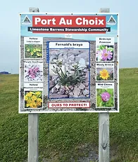
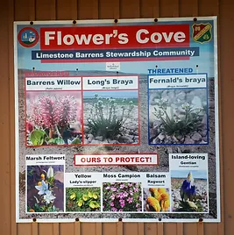
SAM’s Role
Conserving Limestone Barrens Habitat for various Species at Risk, like Wooly Arnica/Long’s Braya
Notes:
SAM’s Role in Conserving Species at Risk Habitat
-SAM works to identify, map and conserve important species at risk habitat across the province
-SAM’s network of communities who practice environmental stewardship across NL, helps contribute to maintaining & enhancing biodiversity in the province
-Currently SAM works with several member communities in protecting the Limestone Barrens Habitat including Port au Choix and Flower’s Cove

Slide 19
What Can You Do?
Education is one of the most important responsibilities we have as stewards of the limestone barrens ecosystem.
Notes:
What Can You Do?
-Education is one of the most important responsibilities we have as stewards of the limestone barrens ecosystem
-In order to protect this unique natural wonder, we must know and be able to teach others about its characteristics
-With an understanding of the barrens, interest in their protection increases
-When people learn about what it is that they have been overlooking as they live on, work on or visit the barrens, they become more interested in preserving them

Slide 20
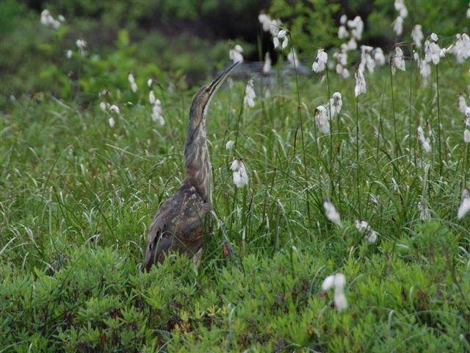
Questions?
Karleena Squires
Outreach Coordinator
Stewardship Association of Municipalities
www.samnl.org
samengagement995@gmail.com

