Slide 1
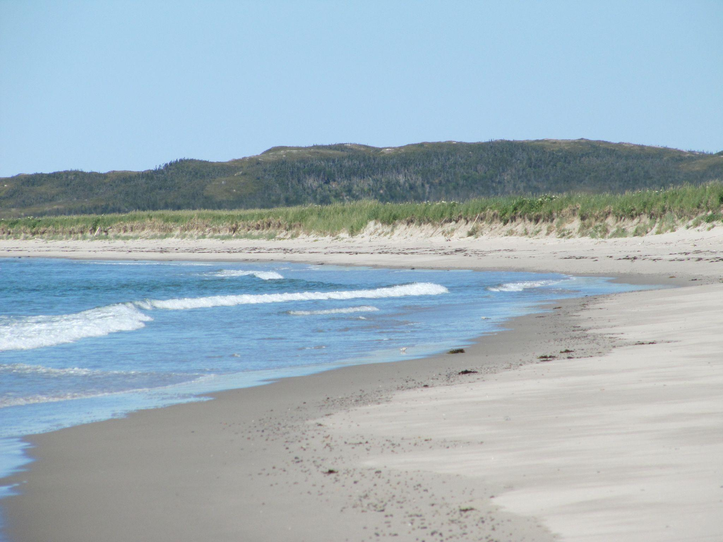
Species at Risk
Programming Created by:
Karleena Squires
Outreach Coordinator

Slide 2
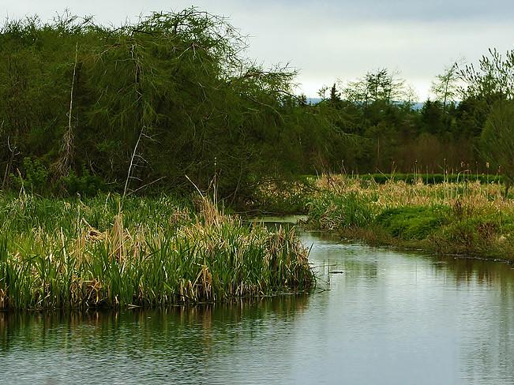
What is a Habitat?
Everything an organism needs to survive:
Food, Water, Shelter
Notes:
What is a Habitat?
-Everything an organism needs to survive: food, water, shelter
-Critical habitat is habitat that belongs to a Species at Risk. In some locations (Port au Choix for example), the Wooly Arnica only grows in a certain location and that location would be its “critical habitat’ - critical to its survival.

Slide 3
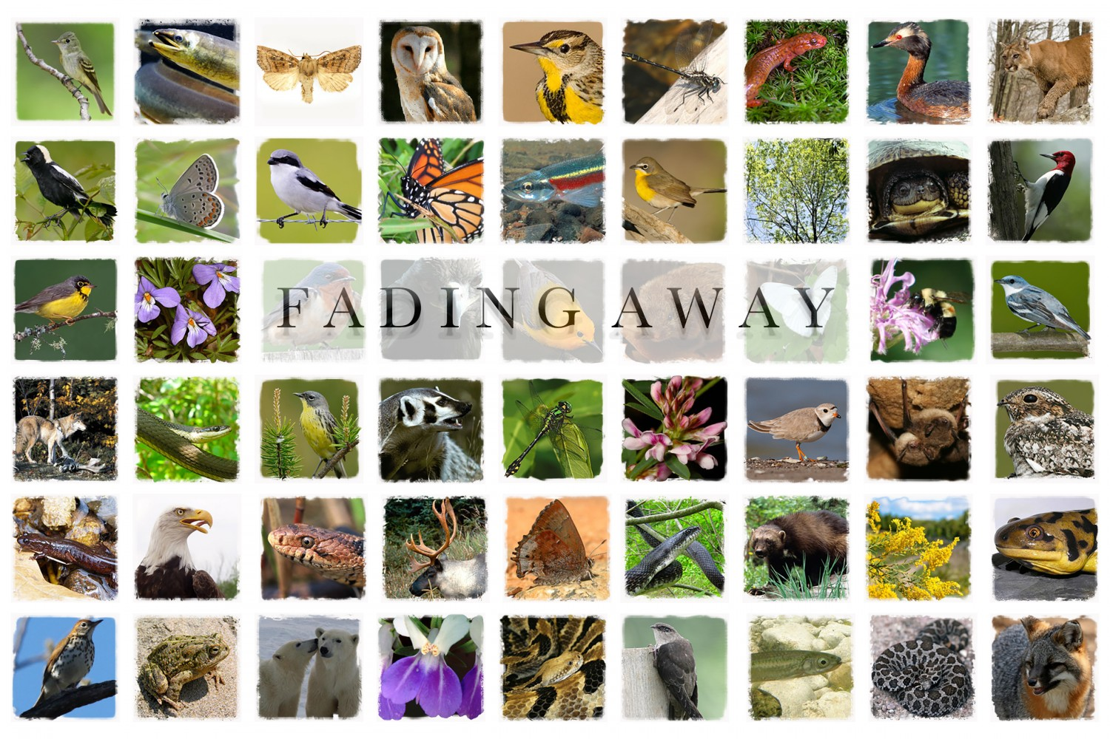
What is a Species at Risk?
Plants and animals that are at risk of disappearing.
Notes:
What is a Species at Risk?
-Plants and animals that may disappear unless human beings step in to help. Very susceptible to population decline.
-Canada is home to about 80,000 species of plants and animals - many of these species are facing numerous threats to their survival
-There are 5 Categories of Risk: vulnerable, threatened, endangered, extirpated and extinct.

Slide 4
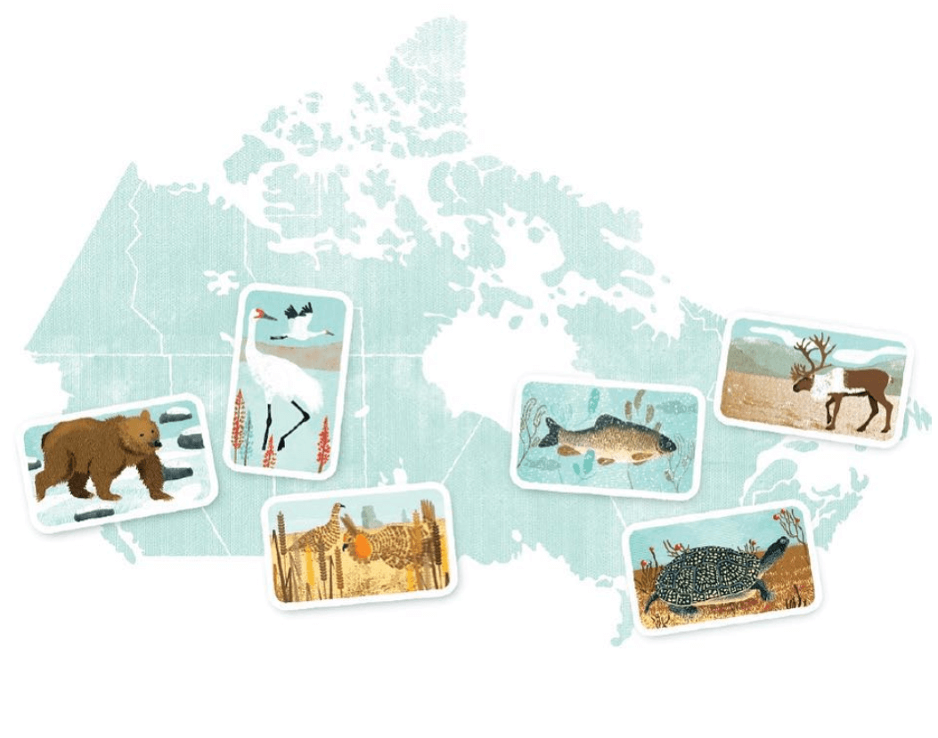
Species at Risk in Canada
Today, over 600 plant and animal species are considered at risk under
Canada’s Species at Risk Act (SARA)
Notes:
Species at Risk in Canada
-With about 80,000 different species of wildlife, Canada has a rich biodiversity - which is a great variety of life.
-Today, over 600 plant and animal species are considered at risk under Canada’s Species at Risk Act (SARA)
-By protecting Species at Risk, you protect biodiversity - which has economic and ethical benefits - as well as protecting the ecosystems that allow humans and wildlife to survive
-Canada has incredible natural wealth:
-from an abundance of animal, fish and plant species, to the wide array of forests, mountains, grasslands and waterways that support them.
-But our wildlife are in trouble — it is obvious that the health of Canada’s wildlife is in decline.
-Canadians stand to lose an important part of our heritage and natural beauty if we fail to protect our endangered species and the habitat they need to survive.

Slide 5
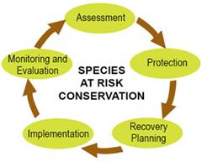
Species at Risk Act
Notes:
Species at Risk Act
-Who determines if a Species is at Risk?
-COSEWIC - The Committee on the Status of Endangered Wildlife in Canada sets out the Species at Risk standards
-COSEWIC is an independent advisory panel to the Minister of Environment and Climate Change Canada that meets twice a year to assess the status of wildlife species at risk of extinction. Members are wildlife biology experts from academia, government, non-governmental organizations and the private sector responsible for designating wildlife species in danger of disappearing from Canada
-The Species at Risk Act (known as SARA) is a key federal government commitment to prevent wildlife species from becoming extinct and secure the necessary actions for their recovery. It provides for the legal protection of wildlife species and the conservation of their biological diversity.
-COSEWIC sets the Species at Risk Act, and the provinces adapt their own policy, so Species at Risk rankings vary depending on what province you are in

Slide 6
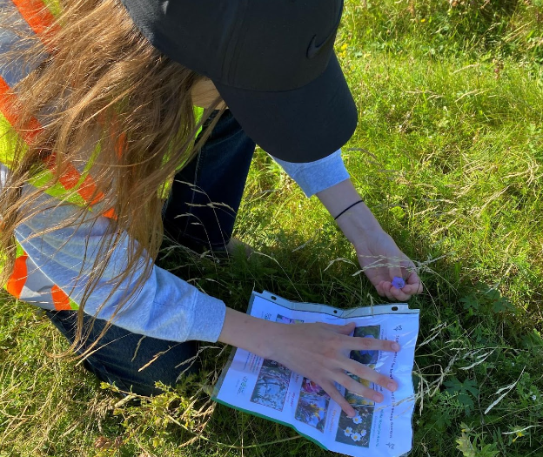
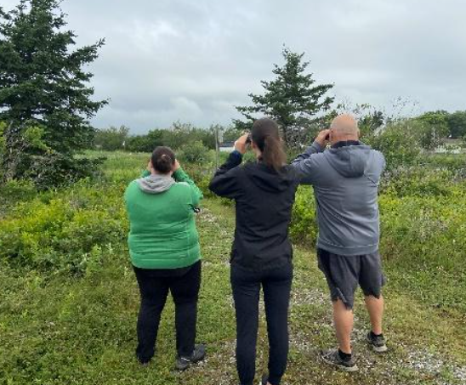
Species at Risk in NL
Currently (as of 2023) there are 68 species listed under the NL Species at Risk Act: 27 of these species are listed as endangered, 10 are listed as threatened and 14 are listed as vulnerable
Notes:
Species at Risk in NL
-Currently (as of 2023) there are 68 species listed under the NL Species at Risk Act: 28 of these species are listed as endangered, 17 are listed as threatened and 23 are listed as vulnerable

Slide 7
Species are threatened by multiple things, but the main threats are:
Pollution
Climate Change
Habitat Loss
Invasive Species
Over-Exploitation
Notes:
Species are threatened by multiple things, but the main threats are:
-Pollution:
-Ecosystems can be exposed to many types of pollutants.
-From agricultural and industrial runoff to microplastics - these contaminants can harm or kill plants and wildlife.
-Climate Change:
-In Canada, the rate of warming has increased to nearly double the global average.
-A rapidly changing climate can make it more difficult for species to find food or migrate.
-Habitat Loss:
-Habitat loss to development is the greatest threat to species in Canada and globally.
-Protecting and restoring natural habitats is one of the most effective ways to help wildlife.
-Invasive Species:
-Introduced species compete with native species for space, food and other resources.
-Some even prey on native species.
-Over-Exploitation:
-Over-exploitation of wildlife can be direct, such as unsustainable hunting, harvesting and poaching, or indirect, including bycatch.

Slide 8
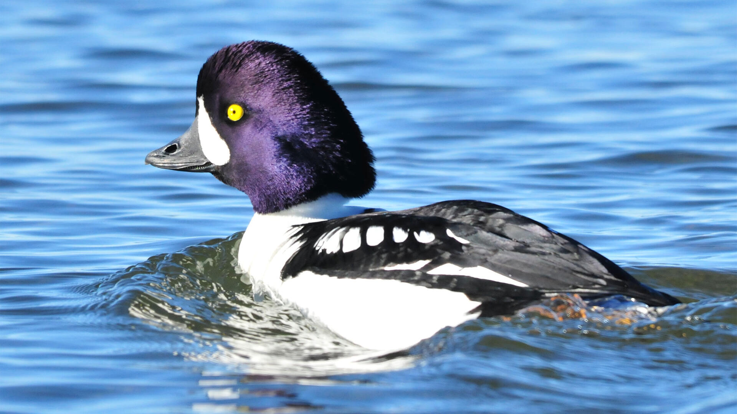
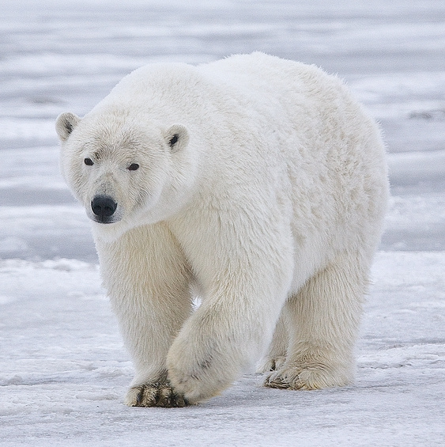
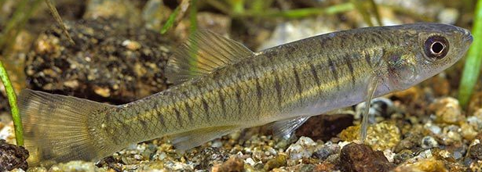
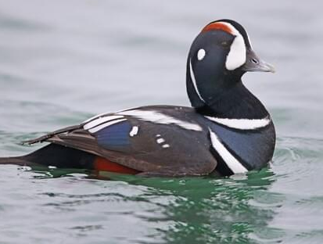
Vulnerable
Barrow’s Goldeneye
Polar Bear
Banded Killifish
Harlequin Duck
Notes:
Vulnerable:
-Has characteristics which make it particularly sensitive to human activities or natural events such as susceptibility to catastrophic events (e.g. oil spill) or restricted habitat or food requirements that are themselves under threat
-This category may also be used to identify a wildlife species that has recovered from threatened or endangered status but which is not yet secure
-Species in this category are likely to become threatened or endangered if not managed effectively

Slide 9
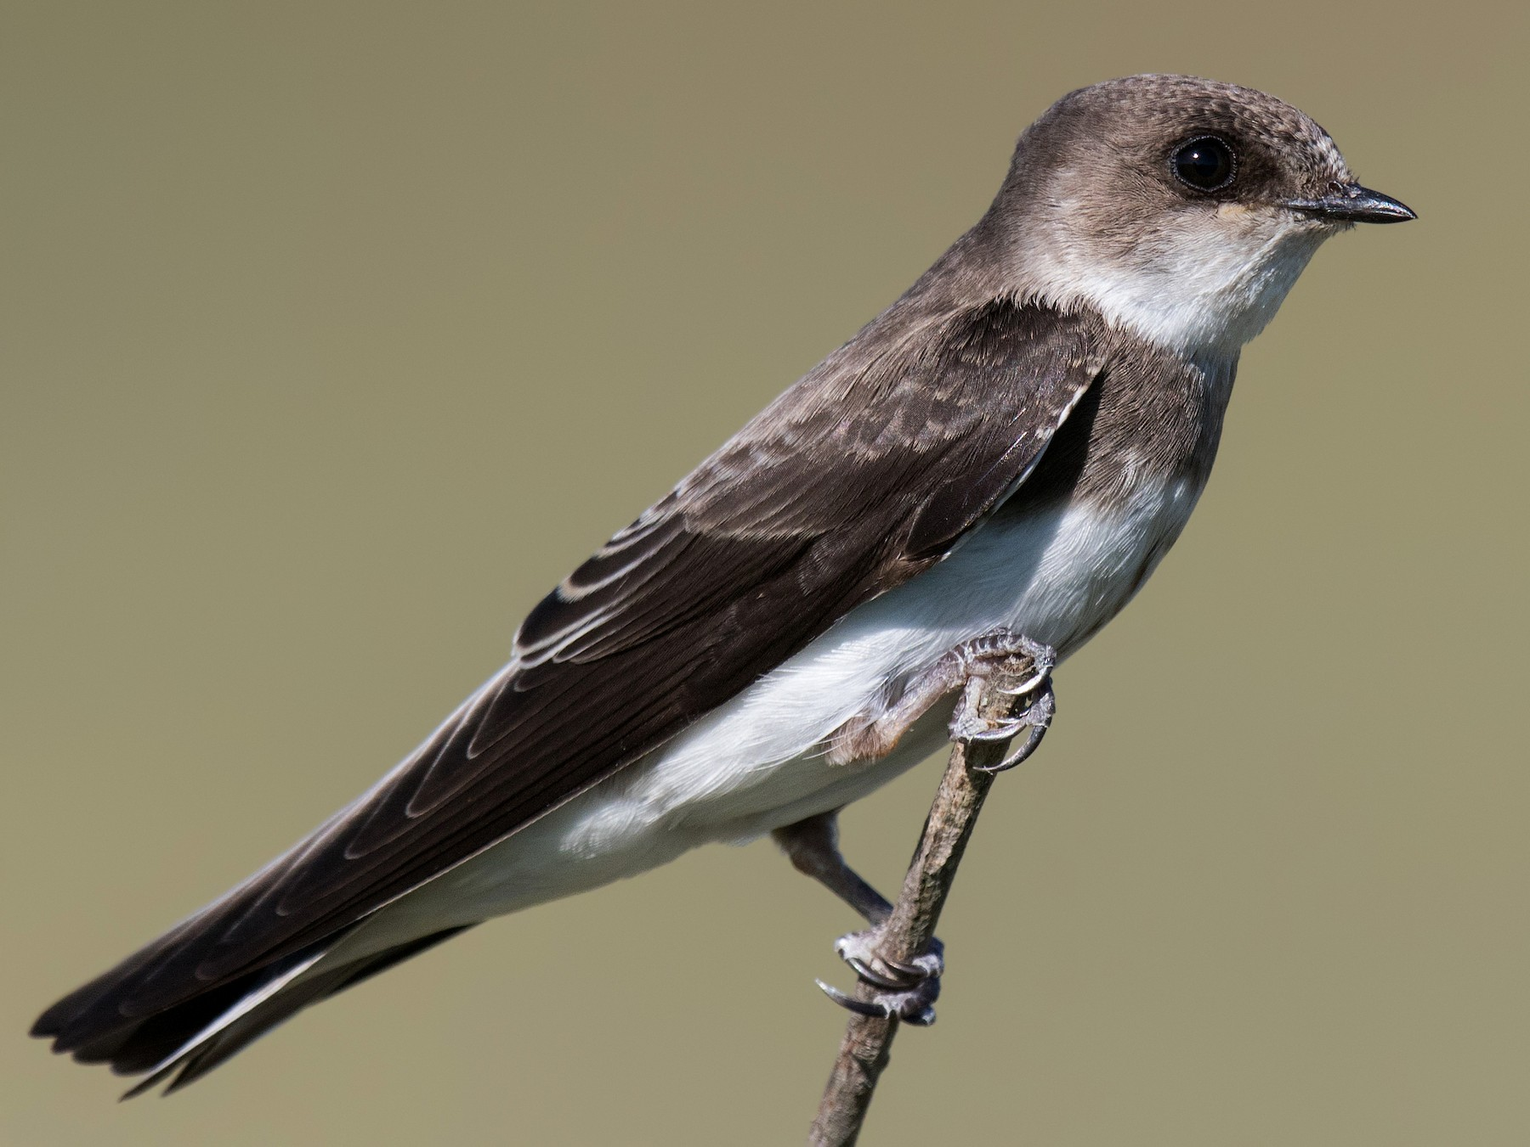
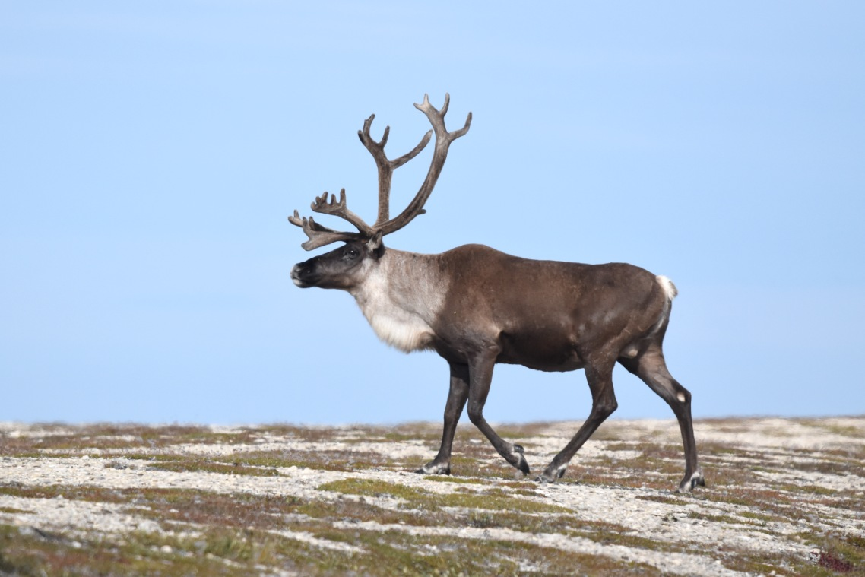
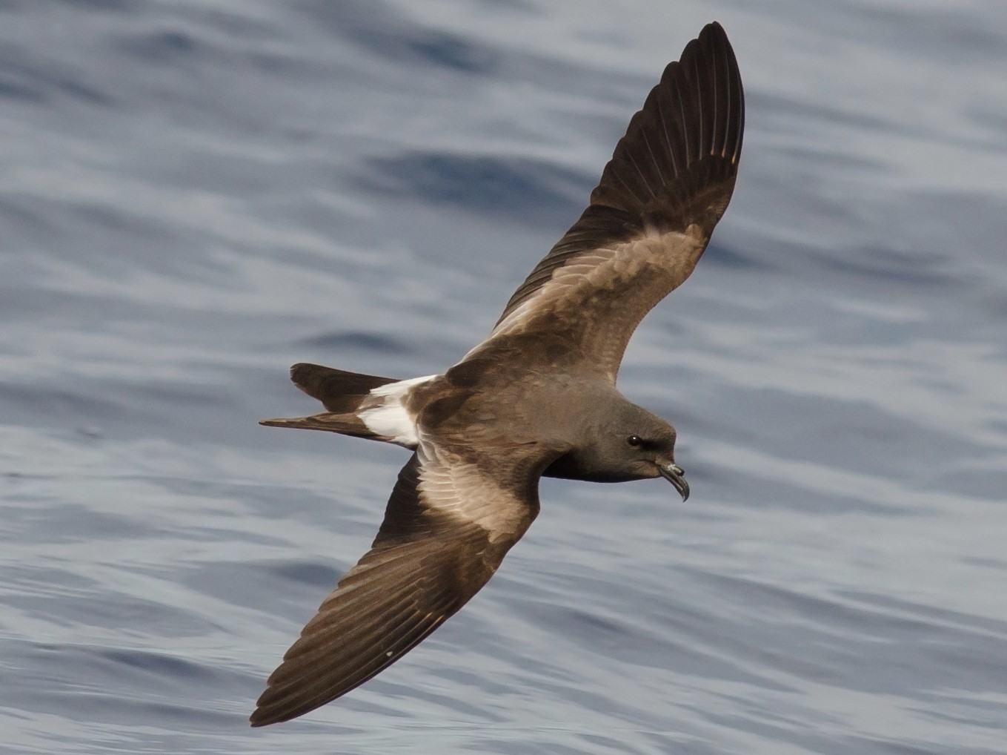
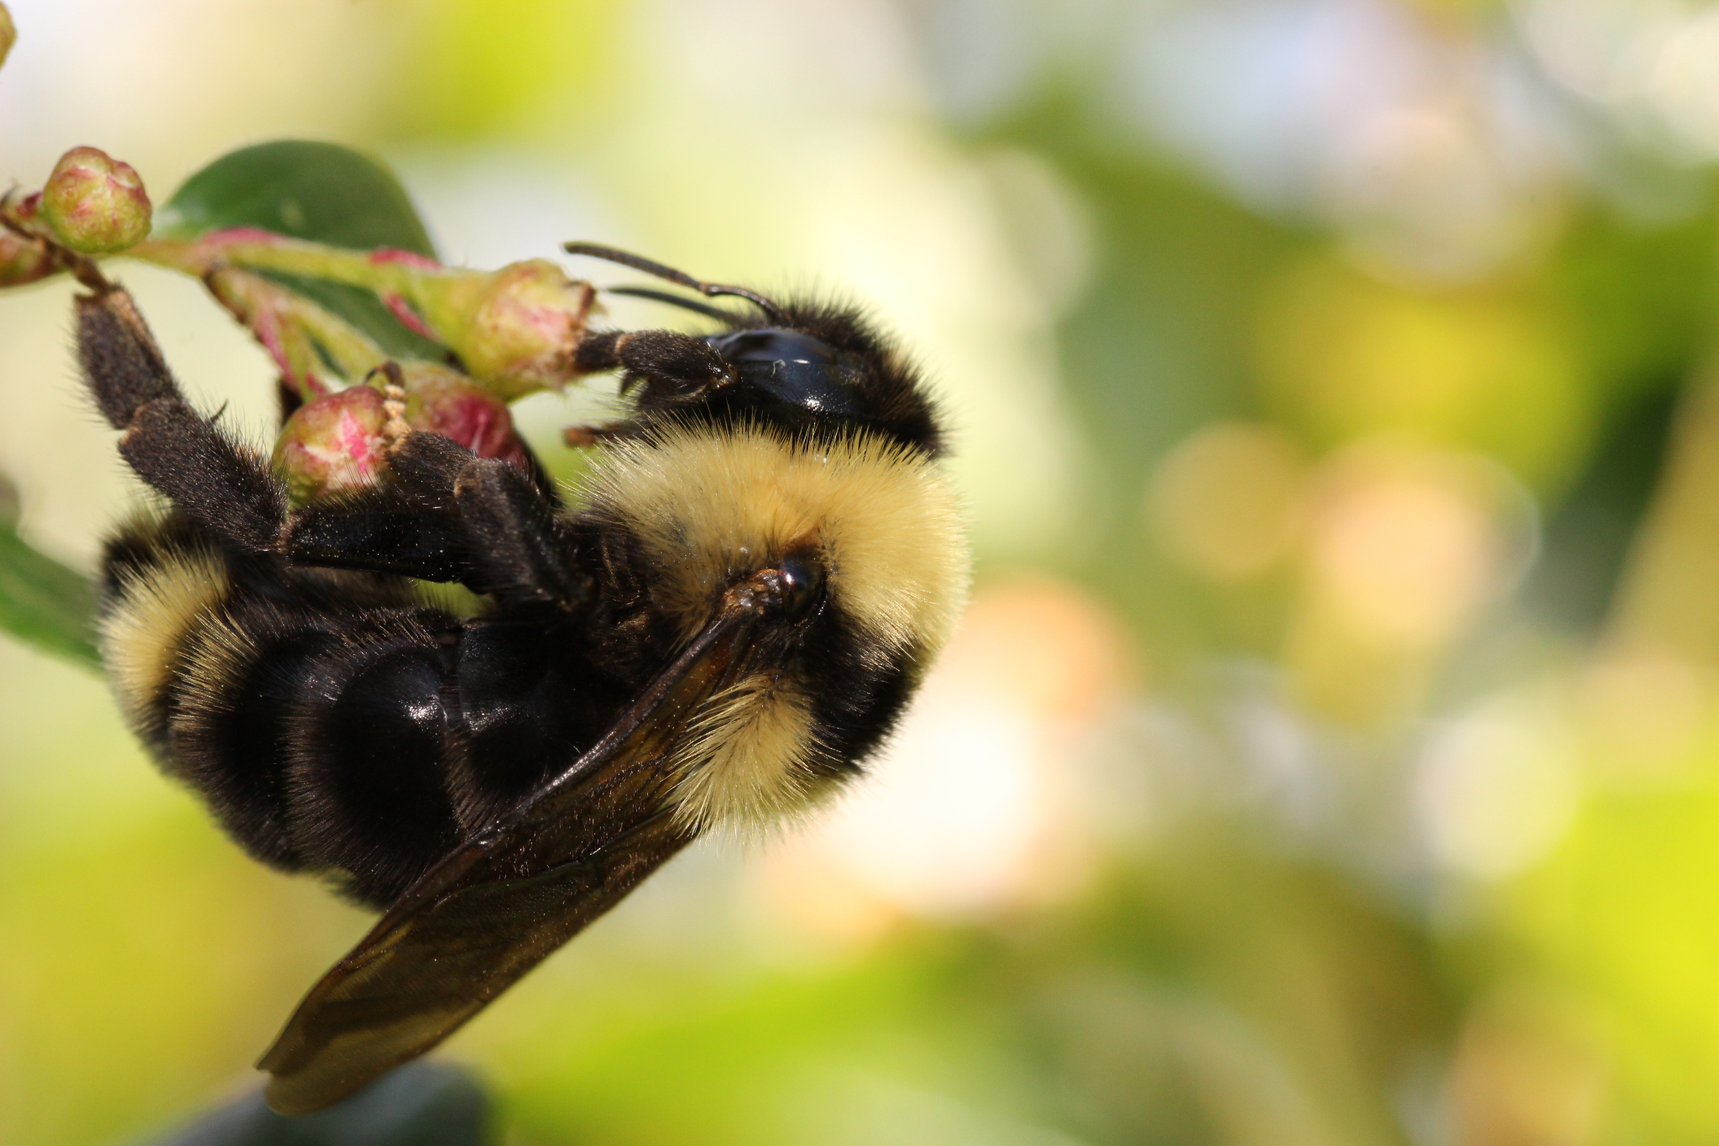
Threatened
Bank Swallow
Boreal Caribou
Suckley’s Cuckoo Bumble Bee
Leach’s Storm Petrel
Notes:
Threatened
-Is likely to become endangered if nothing is done to reverse the factors limiting its survival
-Wildlife in this category can have:
-a declining total population size
-a very small population (<1000 mature individuals)
-an area of occupancy of less than 2000 km2, and/or
-occur at 10 or less locations.

Slide 10
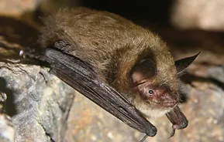
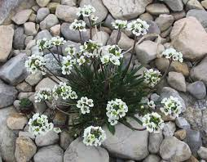
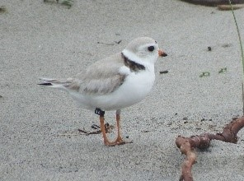
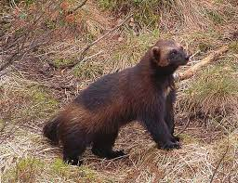
Endangered
Little Brown Bat
Long’s Braya
Piping Plover
Wolverine
Notes:
Endangered
-Faces imminent extirpation or extinction
-Wildlife in this category can have:
-a declining total population size
-a very small population (<250 mature individuals)
-an area of occupancy of less than 500 km2; and/or,
-occur at five or less locations
-Without intervention, these will likely to become extirpated from the province

Slide 11
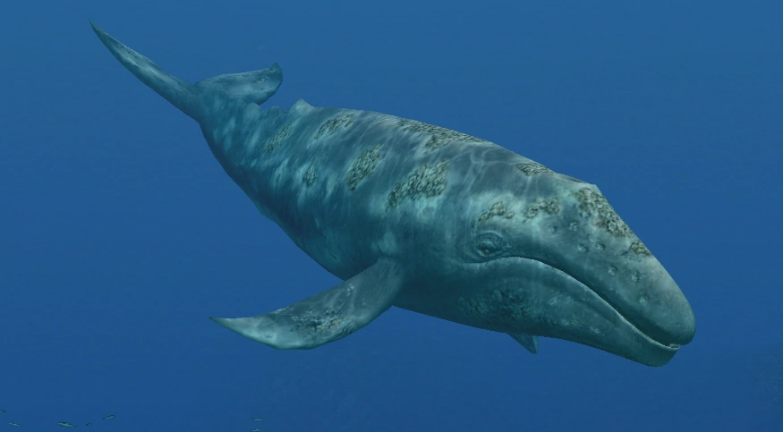
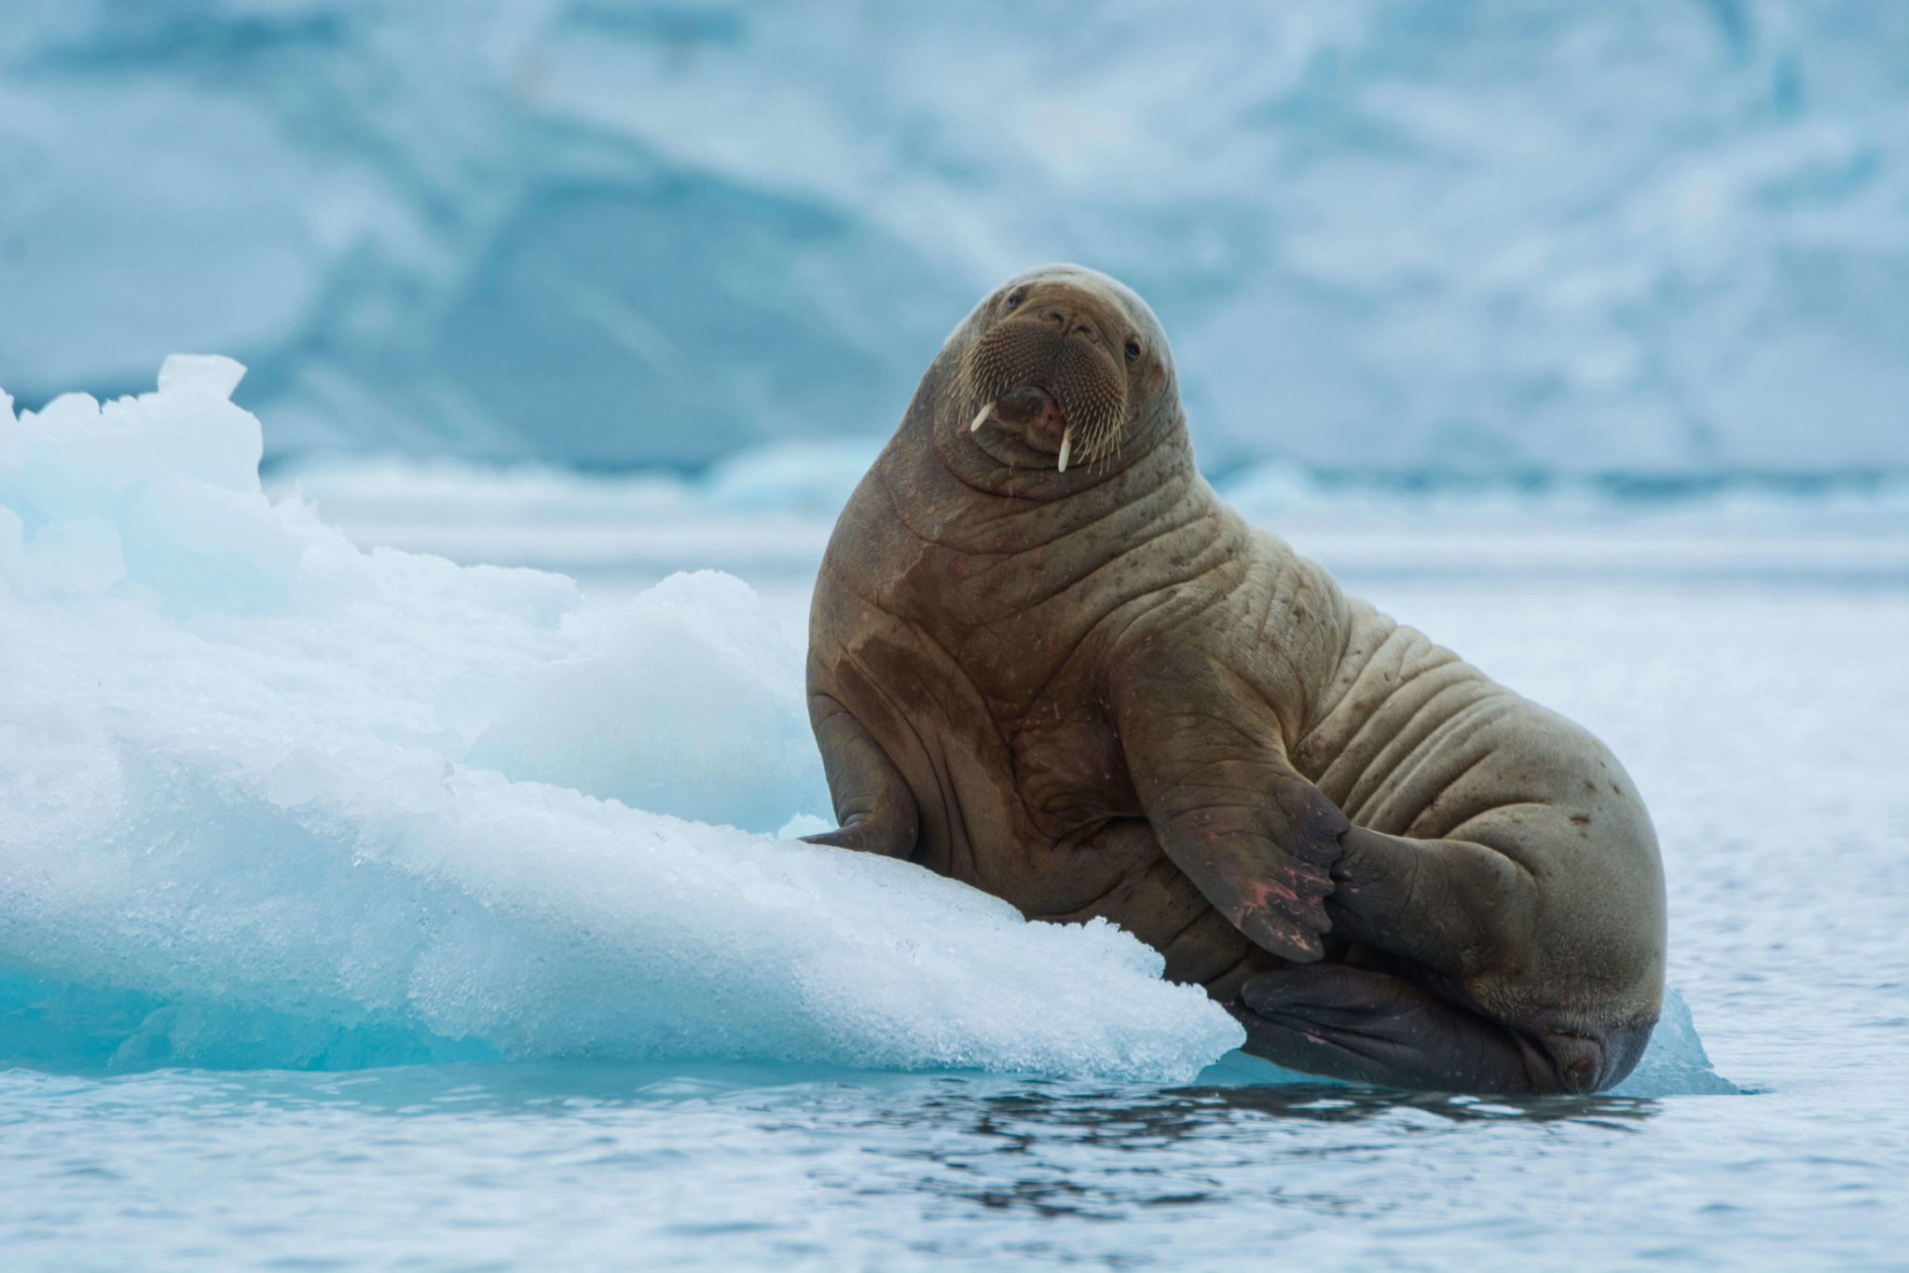
Extirpated
Grey Whale
Atlantic Walrus
Notes:
Extirpated
-No longer exists in the wild, but exists elsewhere (e.g. exists in another province/country, a zoo, or a botanical garden).

Slide 12
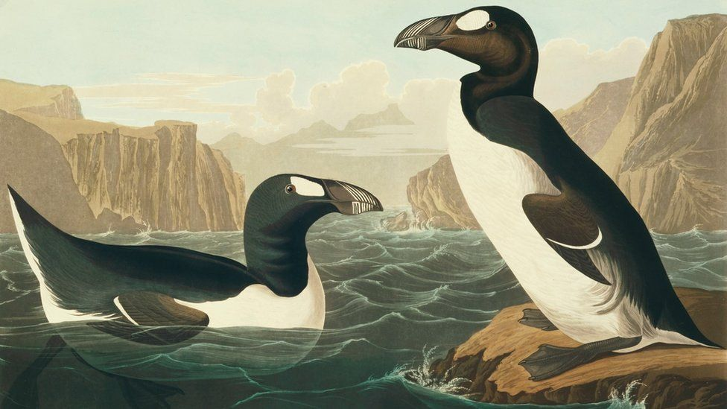
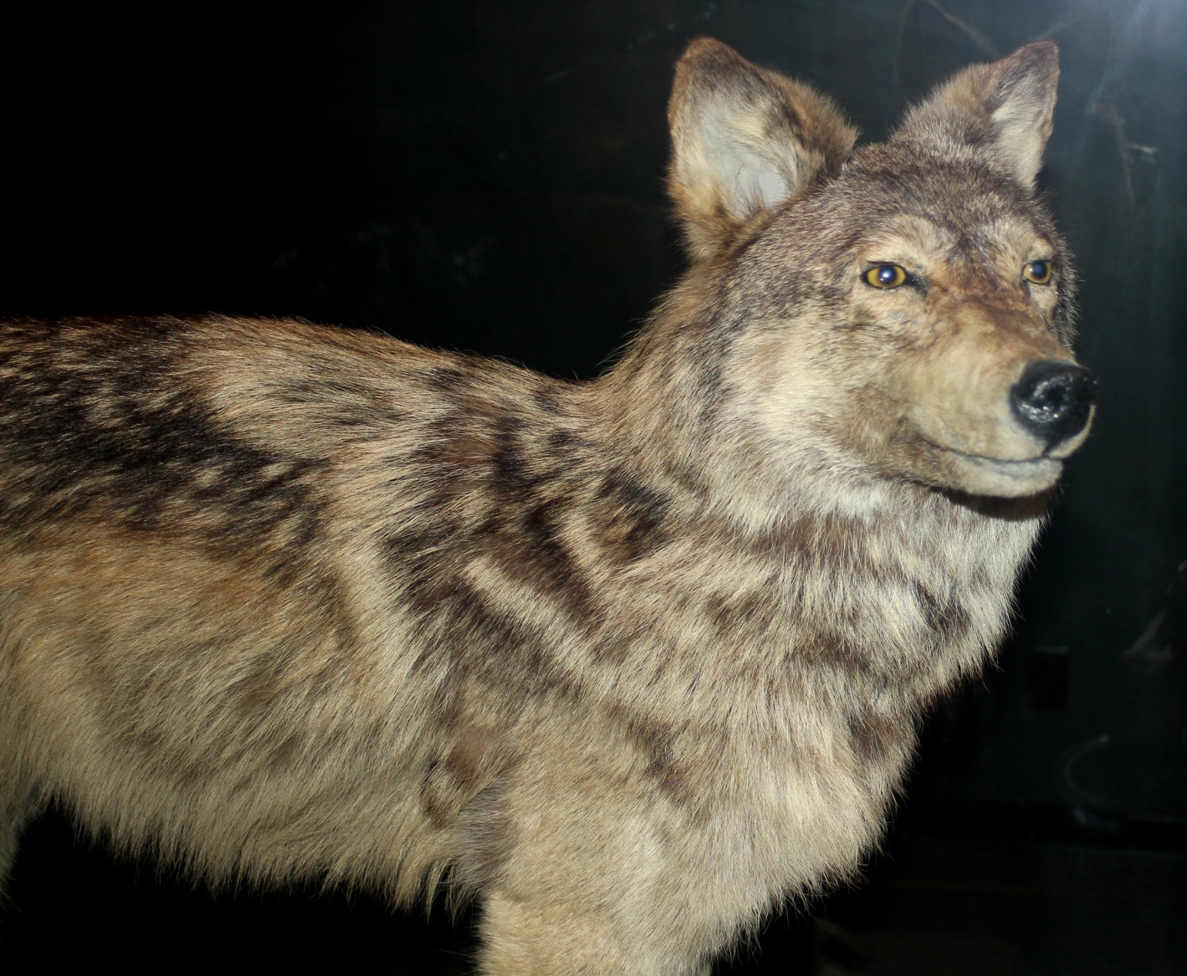
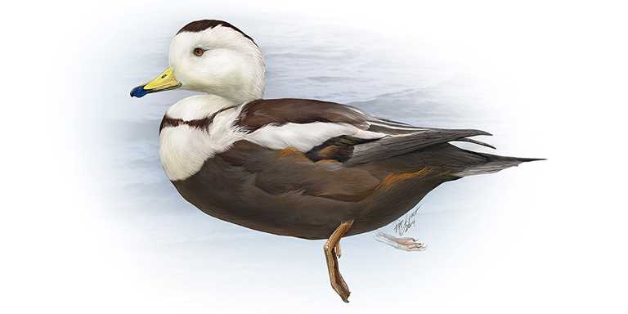
Extinct
Great Auk
Newfoundland Wolf
Labrador Duck
Notes:
Extinct
-No longer exists.

Slide 13
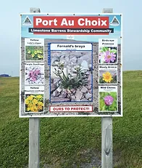
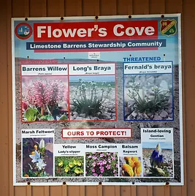
SAM’s Role
Conserving Limestone Barrens Habitat for various Species at Risk, like Wooly Arnica/Long’s Braya
Notes:
SAM’s Role in Conserving Species at Risk Habitat
-SAM works to identify, map and conserve important species at risk habitat across the province
-SAM’s network of communities who practice environmental stewardship across NL, helps contribute to maintaining & enhancing biodiversity in the province
-Currently SAM works with several member communities in protecting Species at Risk Habitat including:
-Main Brook/St. George’s: Atlantic Salmon Habitat
-Port aux Basques/Burgeo: Piping Plover Habitat
-Whitbourne: Blue Felt Lichen
-Port au Choix/Flower’s Cove: Limestone Barrens (plants like Long’s Braya, Wooly Arnica)
-Cartwright: Common Eider Ducks/Harlequin Ducks/Peregrine Falcon Habitat
-Mary’s Harbour/Red Bay/St. Lewis: Common Eider Ducks/Harlequin Ducks Habitat
-St. Anthony: Common Eider Ducks

Slide 14
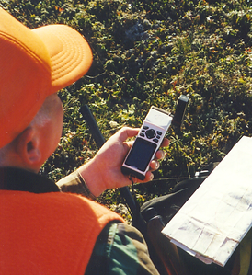
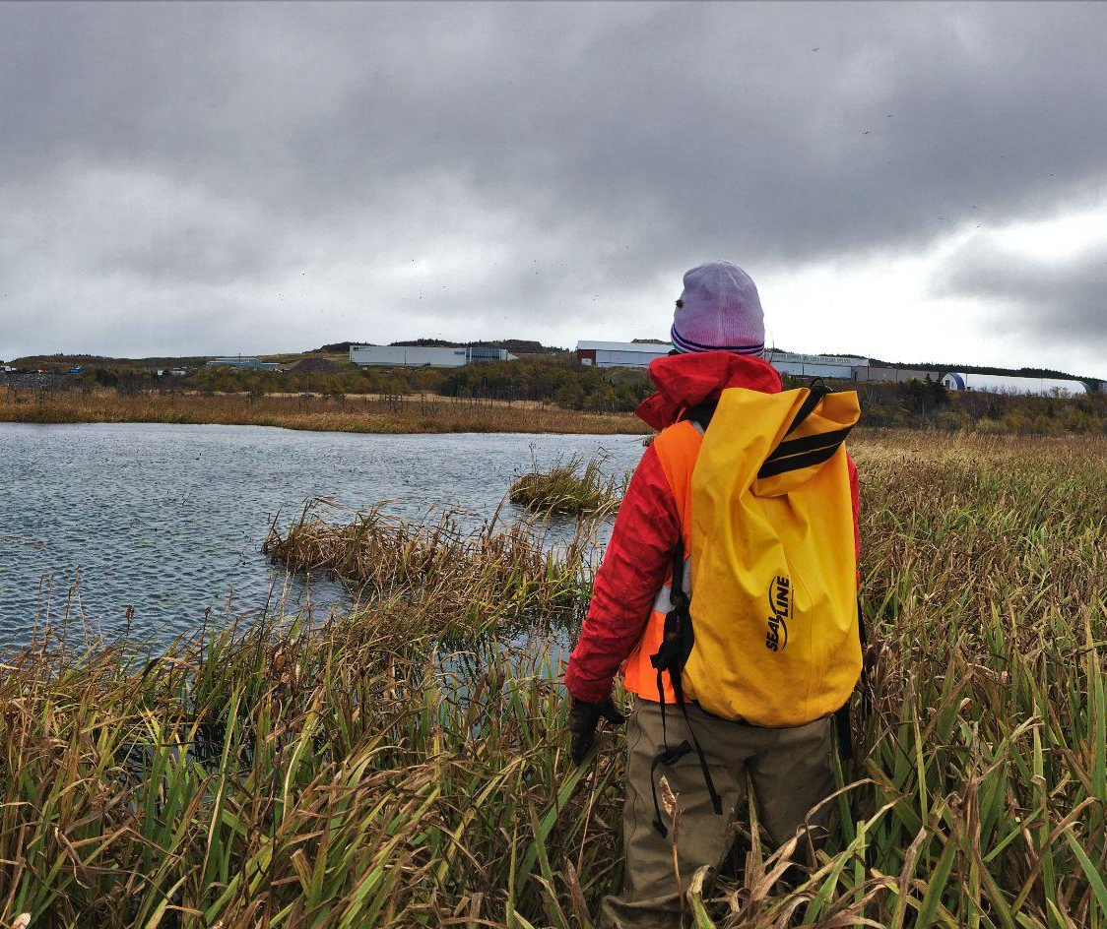
What Can Be Done?
Notes:
What can be done?
For threatened species to recover, we can:
-Assist with Citizen Science Projects to help monitor wildlife such as the SAM Nesting Box Program, Birds Canada’s Breeding Bird Atlas or Nocturnal Owl Survey, etc.
-Conserve wildlife habitat by organizing clean-ups or tree-plantings in your community
-Encourage your Municipality to take concrete action to ensure sufficient habitat is restored and maintained
-Encourage your Municipality to join SAM to help identify critical habitat for Species at Risk

Slide 15
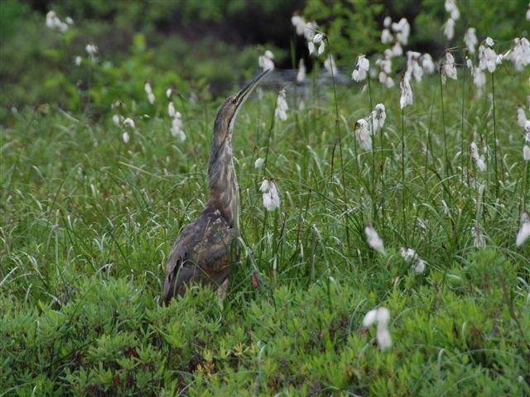
Questions?
Karleena Squires
Outreach Coordinator
Stewardship Association of Municipalities
www.samnl.org
samengagement995@gmail.com

