Slide 1
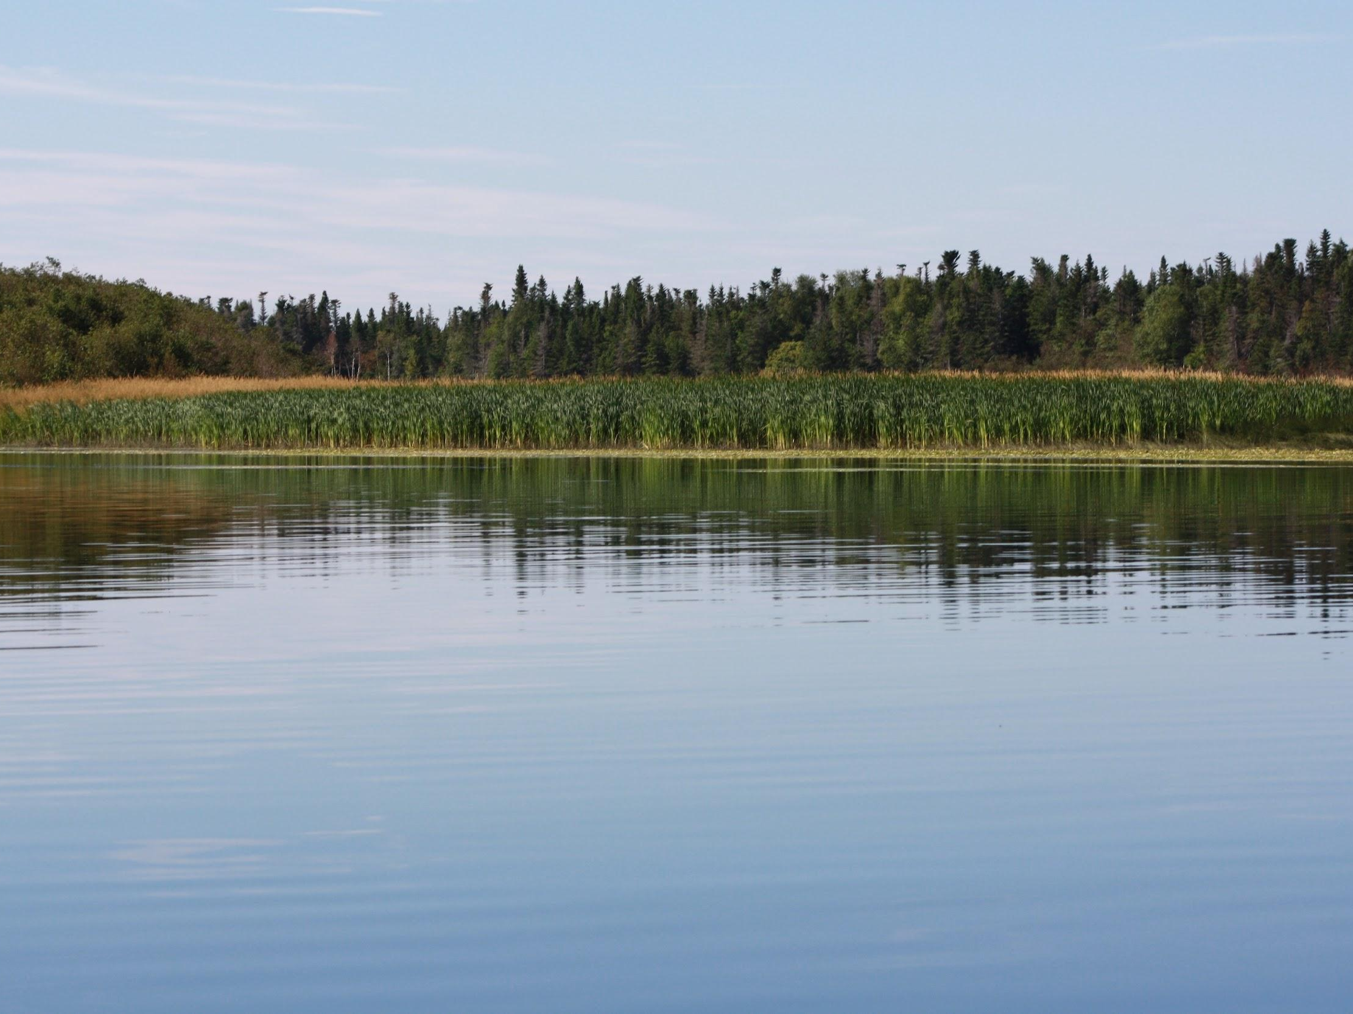
Wetlands 101
Programming Created by:
Karleena Squires
Outreach Coordinator
Stewardship Association of Municipalities Inc.

Slide 2
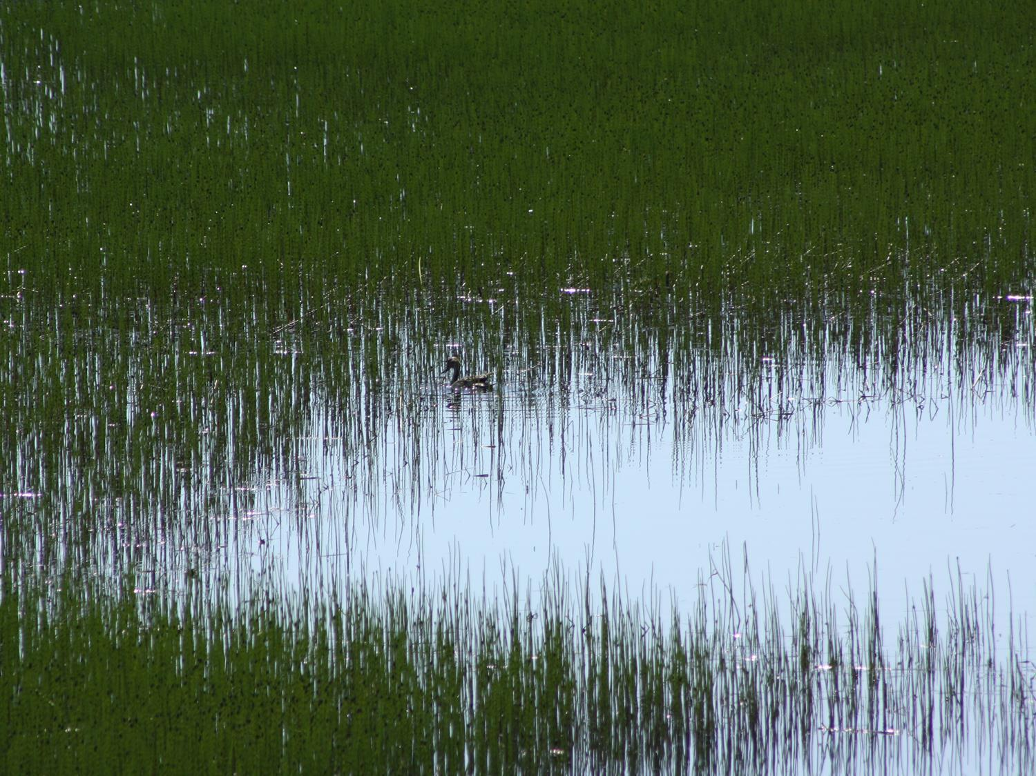
What is a Wetland?
Land that is covered by or saturated with water for at least part of the year.
Notes:
What is a wetland?
-Basically wetlands are WET LAND
-Land that is covered by or saturated with water for at least part of the year.
-Usually made up of either peat land or open water

Slide 3
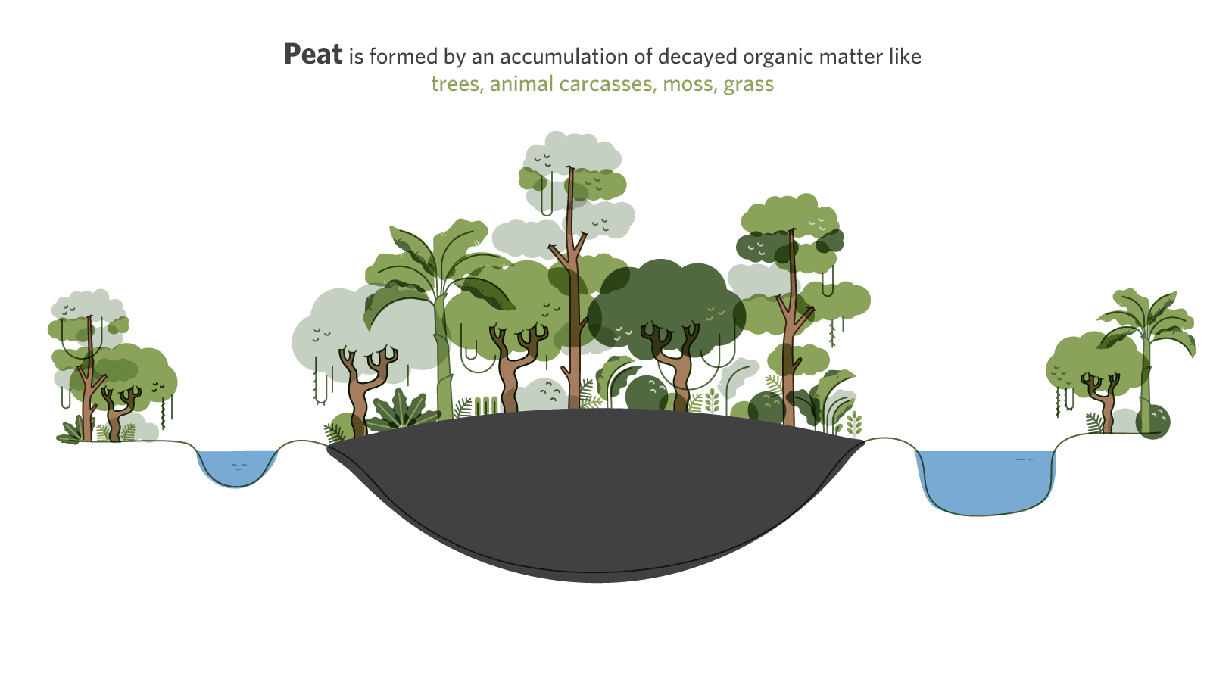
What is Peatland?
Notes:
-Peatlands are an accumulation of partially decayed vegetation or organic matter like trees, animal carcasses, moss and grass.
-It takes approximately 1000 years to grow just 1.5 meters of peat.

Slide 4
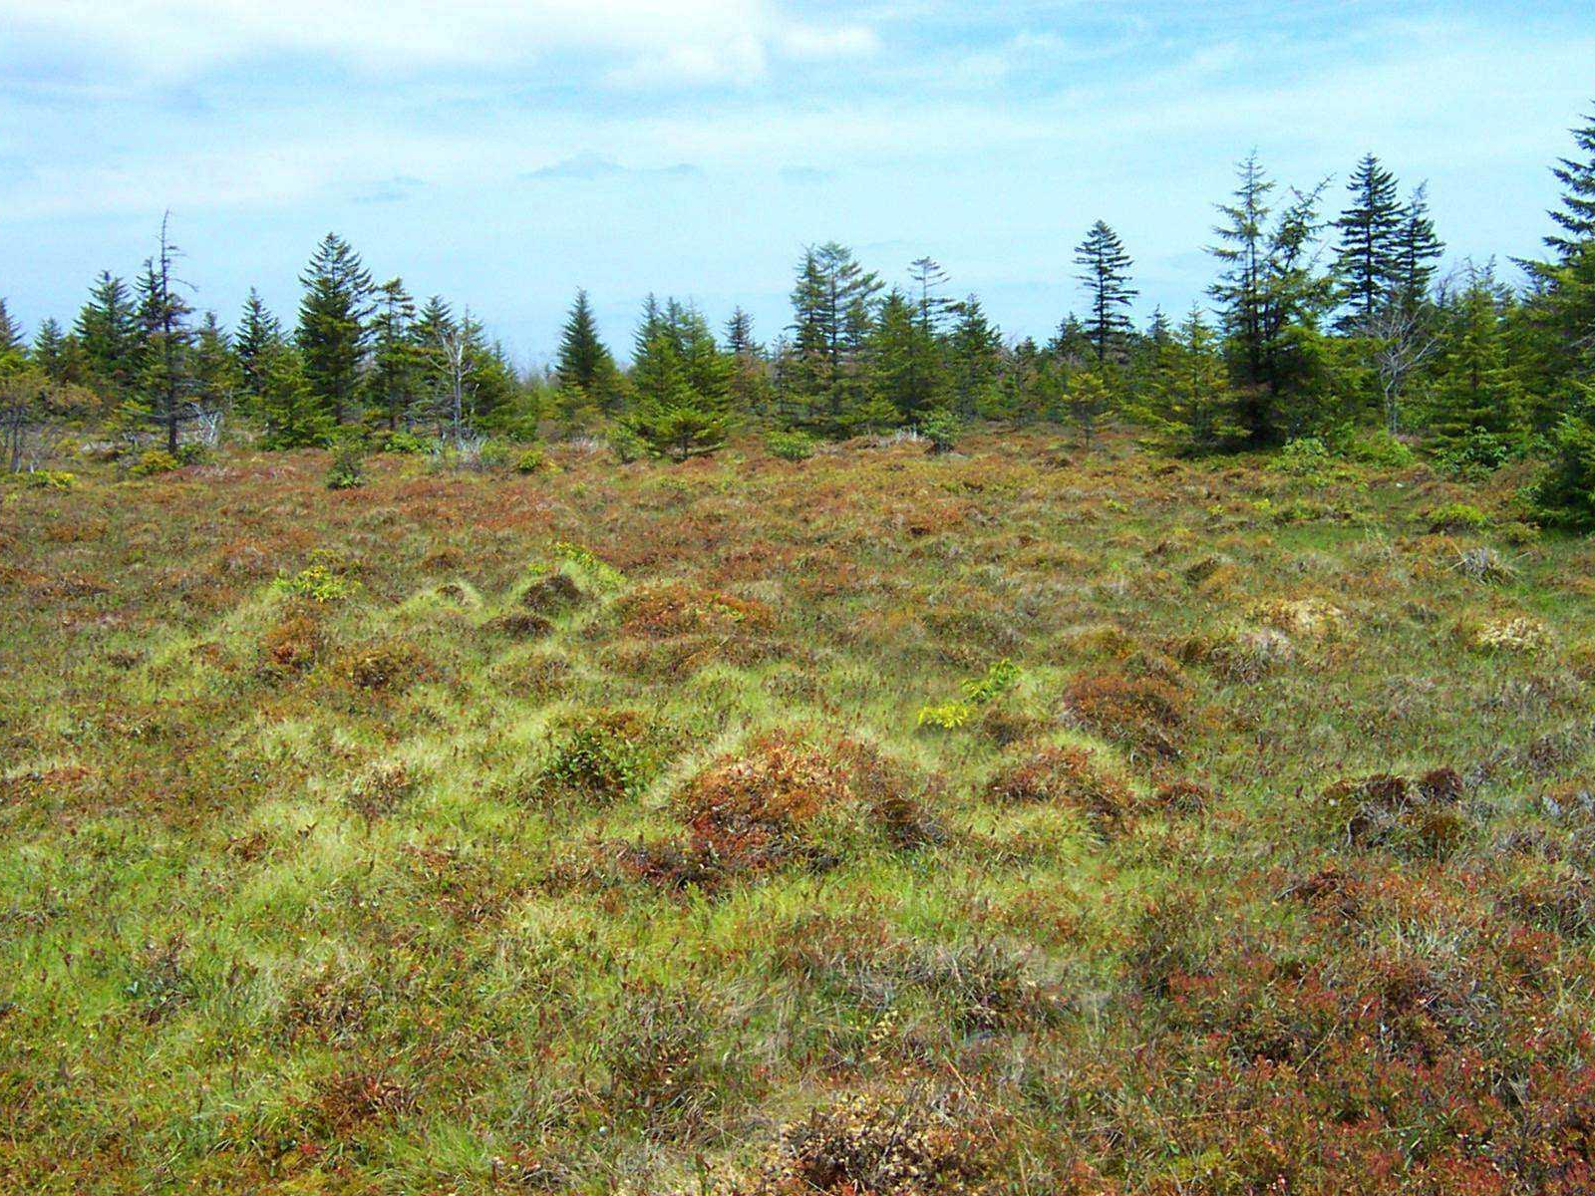
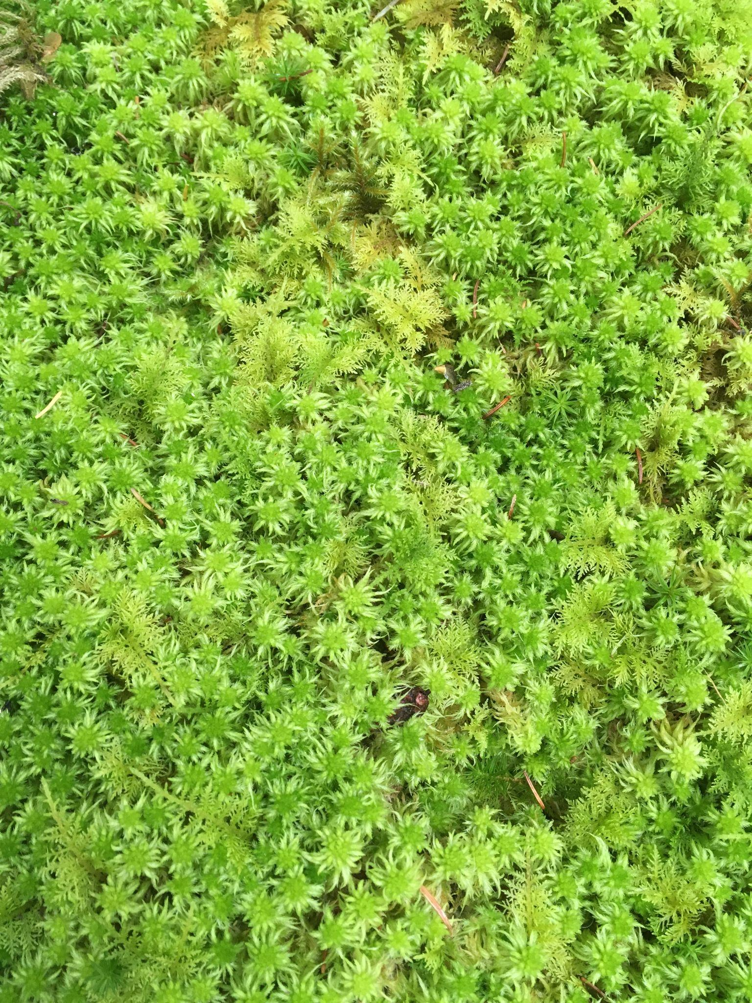
Bogs
Sphagnum Moss
Notes:
Bogs:
-consists mostly of soft, spongy ground consisting mainly of peat
-receive water exclusively from precipitation and are not influenced by groundwater
-vegetation is dominated by sphagnum moss (peat moss), ericaceous shrubs and black spruce trees
-very common in NL

Slide 5
Fens
Notes:
Fens
-usually located in a low-lying area
-wholly or partly covered with water and dominated by grasses and grasslike plants
-peatland that are fed by mineral-rich ground or surface water, but has slow internal seepage, and a general lack of nutrients
-usually has a high diversity of plant life because they will have a source of fresh water associated with them, like a pond, stream or groundwater

Slide 6
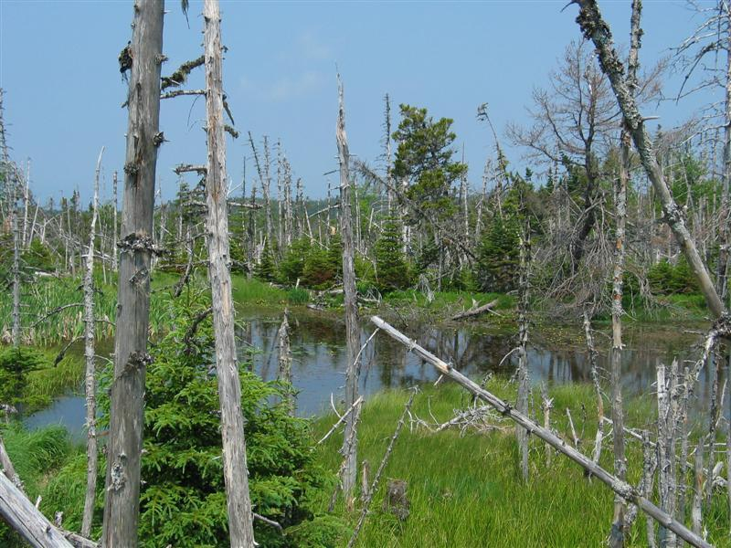
Swamps
Picture Ducks Unlimited Canada
Notes:
Swamp
-peatland often found between the transition of a upland forest and other wetland areas
-dominated by trees and shrubs; snags (standing dead trees) and deadwood (dead parts on a tree) are usually present
-can be fresh water, brackish water or salt water
-waters are rich in dissolved minerals
-ability to slow water flow during floods and protect shorelines from erosion and sedimentation.

Slide 7
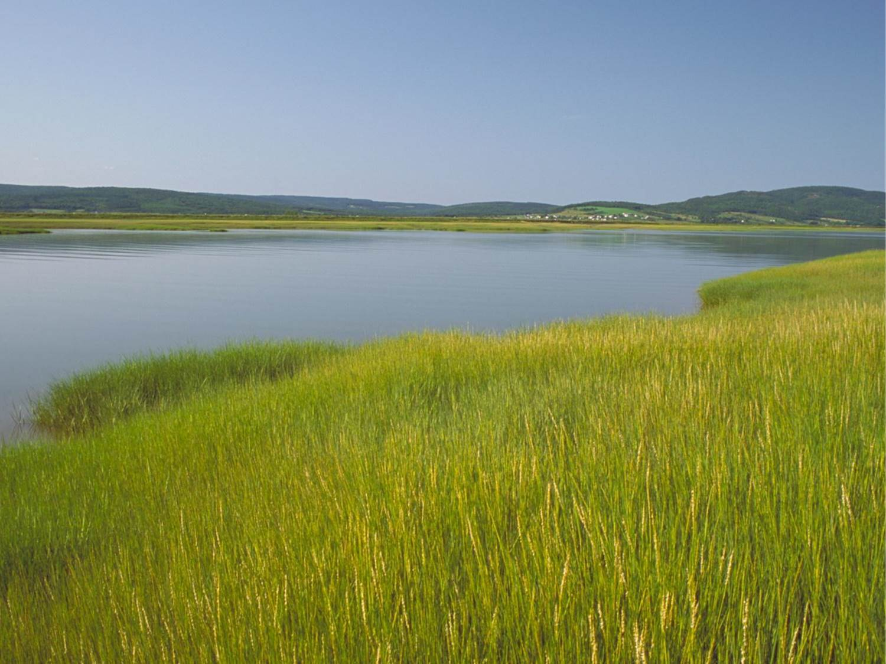
Marshes
Picture Ducks Unlimited Canada
Notes:
Marsh
-periodic or persistent standing water or slow moving surface water
-generally nutrient-rich
-often found in the transition between ponds and shorelines
-vegetation is dominated by graminoids, shrubs or emergent plants and covers more than 25% of the open water
-the most ecologically diverse: they are also important habitat for waterfowl, beavers, moose and other wildlife
-excellent at controlling flooding

Slide 8
Shallow Open Water (Pond)
Picture Ducks Unlimited Canada
Notes:
Shallow Open Water (Pond)
-wetlands with free surface water up to 2m deep
-present for all or most of the year
-less than 25 % of the surface water area covered by standing vegetation
-submerged or floating plants usually dominate the vegetation

Slide 9
Wetlands Have Many Values!

Slide 10
Recreation
Notes:
Recreation: can be used for a variety of recreational reasons including water activities (canoeing/kayaking), bird watching, fishing, etc

Slide 11
Biodiversity
Notes:
Biodiversity: wetlands contribute to biodiversity as they are home to a diverse range of plant and animal species

Slide 12
Environment
Notes:
Environment: wetlands are carbon sinks, storing up to 2 trillion tonnes of the world’s carbon

Slide 13
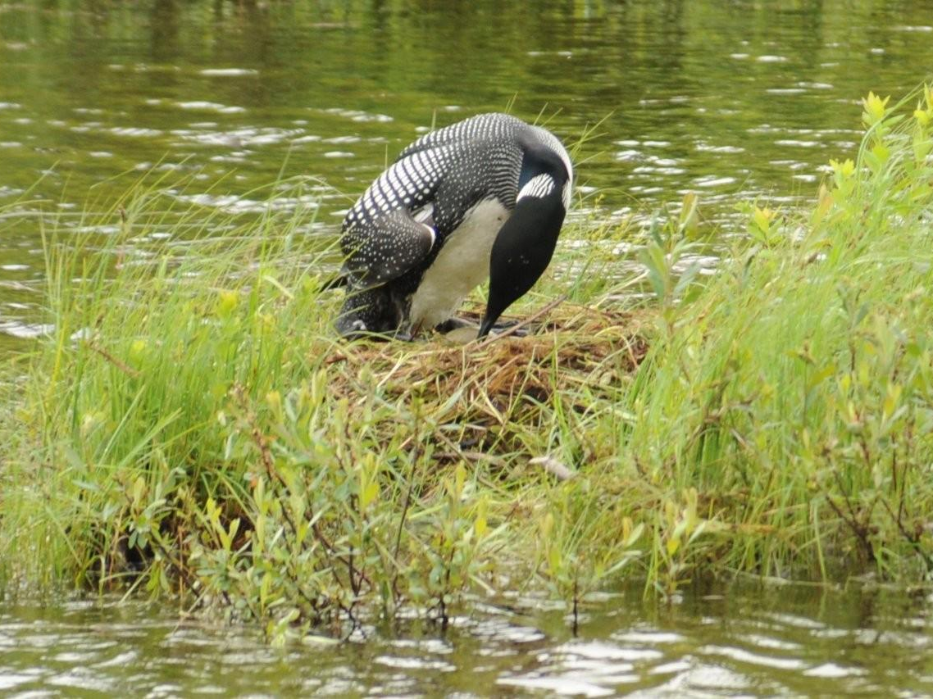
Habitat
Notes:
Habitats: Wetlands provide shelter for wildlife, including migratory birds, who can stop for a rest while on their journey.

Slide 14
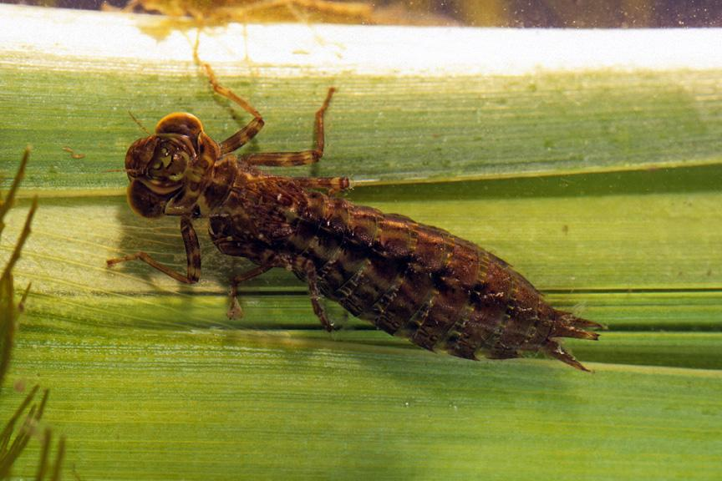
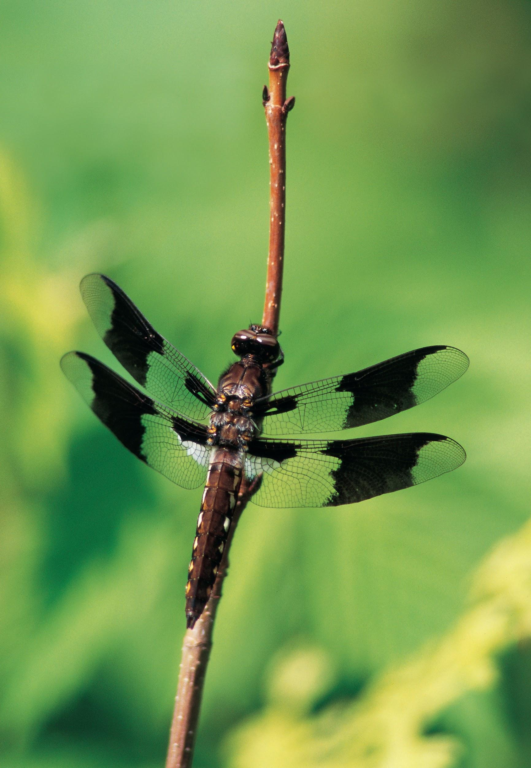
Nurseries
Notes:
Nurseries: Wetlands provide a stable nursery for wildlife to have and/or raise their young.
-Like this dragonfly - dragonflies spend approximately 2 years living in the waters of a wetland as a nymph before emerging as a beautiful dragonfly.

Slide 15
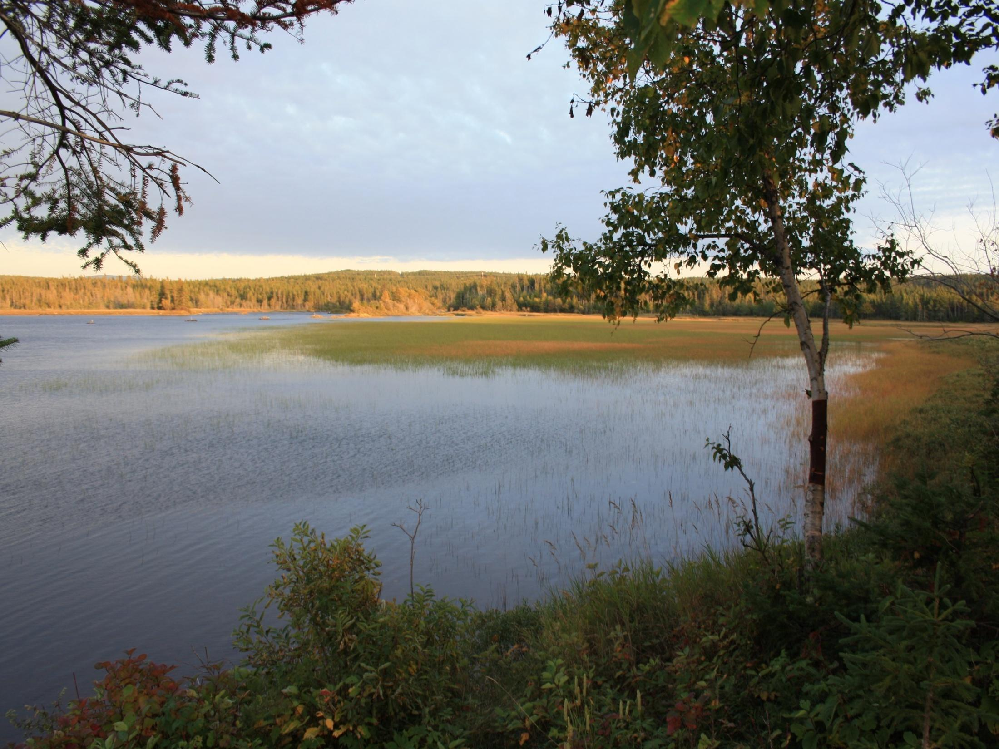
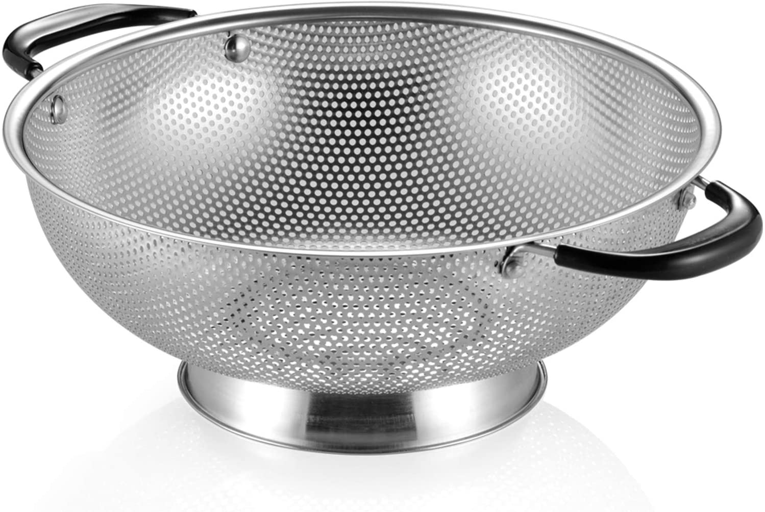
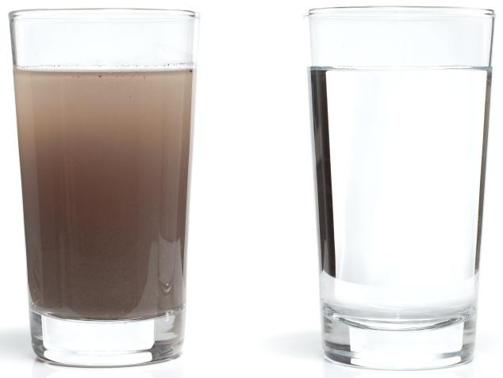
Filters
Notes:
Filters: Wetlands are natural filters, like a strainer! They clear out toxins in the water like our kidneys filter toxins out of our bodies. Just like soap, wetlands help to cleanse the environment and helps provide cleaner drinking water and better food.

Slide 16
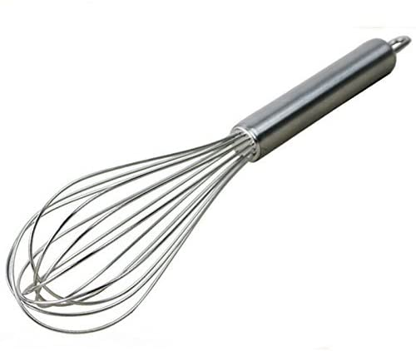
Whisk
Notes:
Whisk: Wetlands help to mix nutrients and oxygen into the water, which are important for fish and other wildlife.

Slide 17
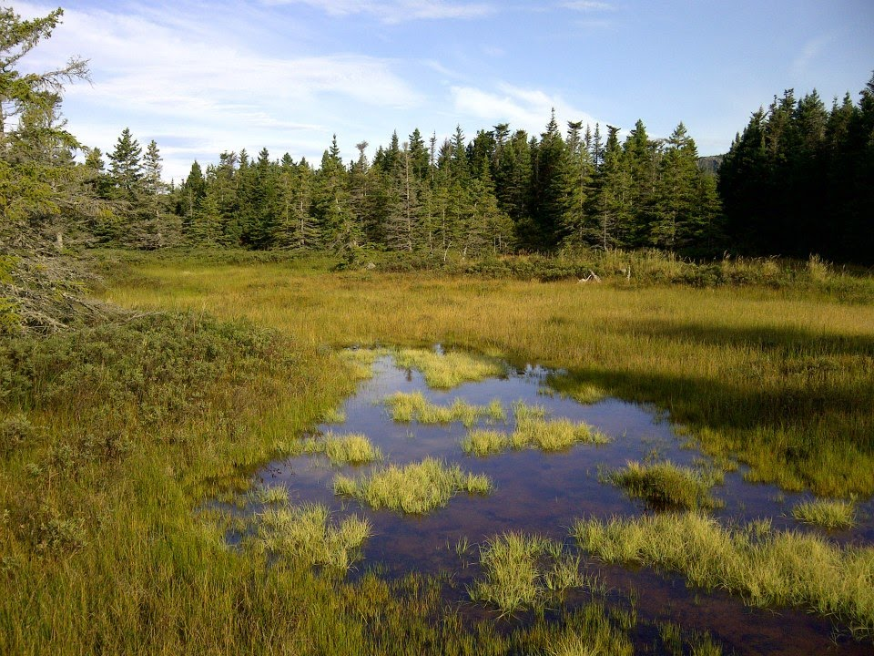
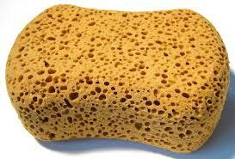
Sponges
Notes:
Sponges: Wetlands, like a sponge, absorb excess water during extreme weather events, and release it slowly during drier times, helping to reduce the risk of floods and droughts.

Slide 18
Hydrology
Notes:
Hydrological: stabilizes our water supply, protects from erosion

Slide 19
Economy
Notes:
Economy: by helping to protect areas from floods, they help save property value

Slide 20
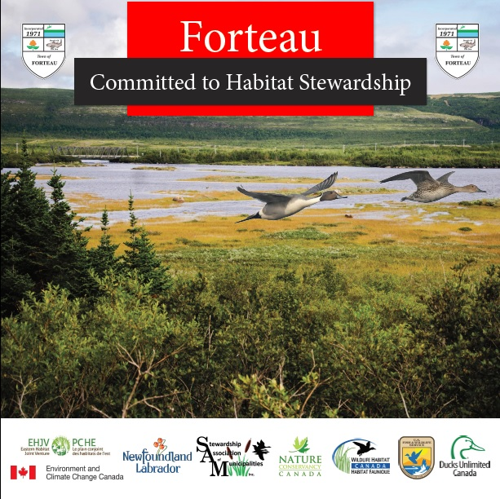
SAM’s Role
Notes:
SAM works to identify, map and conserve important wetlands across the province
SAM’s network of communities who practice environmental stewardship across NL, helps contribute to maintaining & enhancing biodiversity in the province

Slide 21
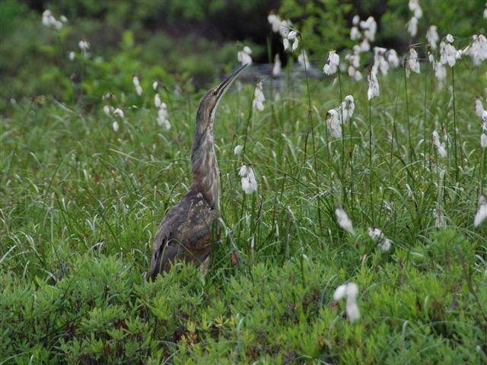
Questions?
Karleena Squires
Outreach Coordinator
Stewardship Association of Municipalities
www.samnl.org
samengagement995@gmail.com

Slide 22
“Name That Duck”
Activity

Slide 23
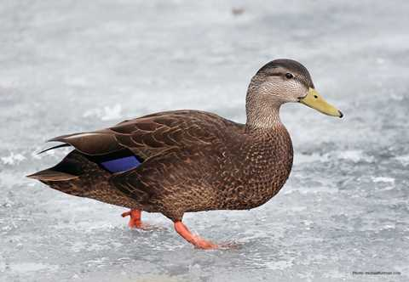
1
Picture: Ducks Unlimited Canada
Picture: Ducks Unlimited Canada
Notes:
American Black Duck (male)

Slide 24
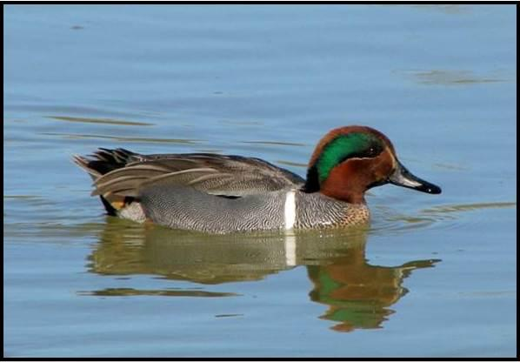
2
Notes:
Green Winged Teal (male)

Slide 25
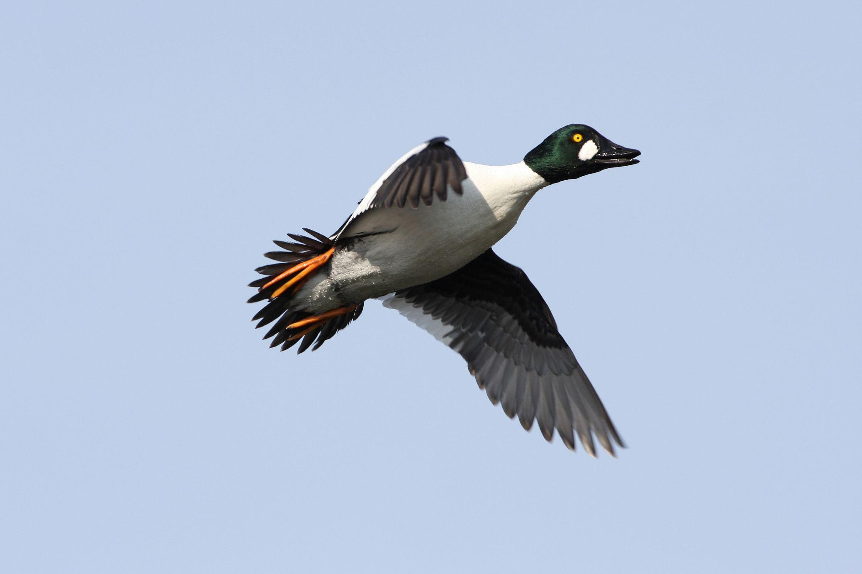
3
Notes:
Common Goldeneye (male)

Slide 26
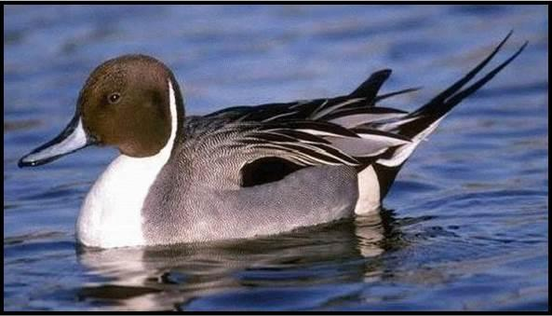
4
Notes:
Northern Pintail (male)

Slide 27
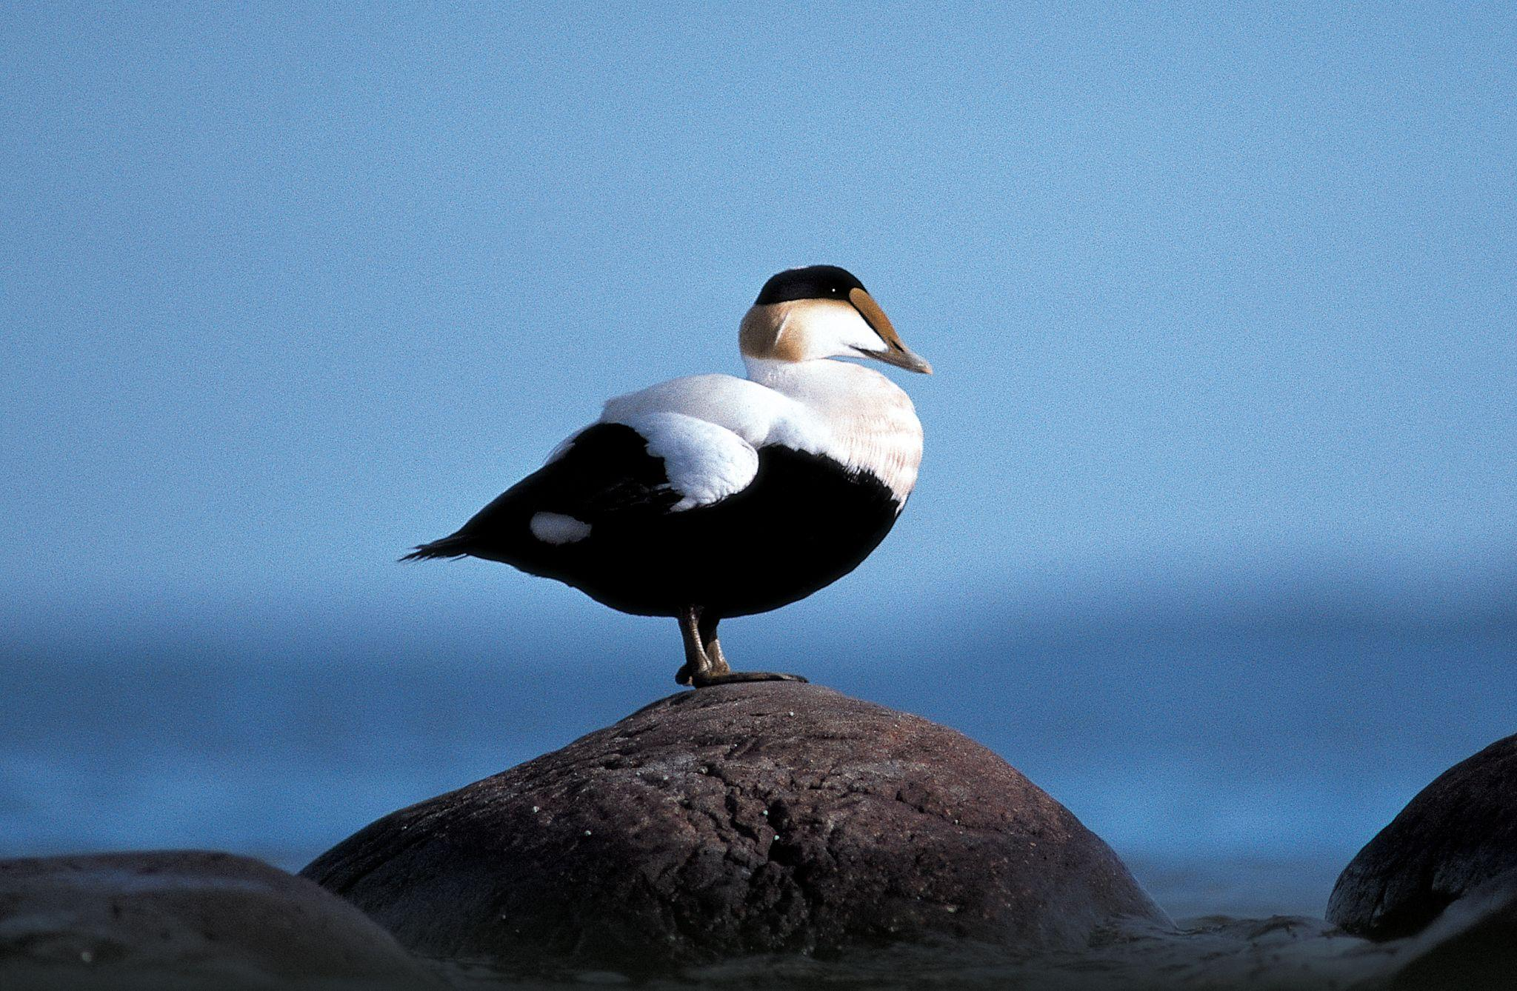
5
Notes:
Common Eider (male)

Slide 28
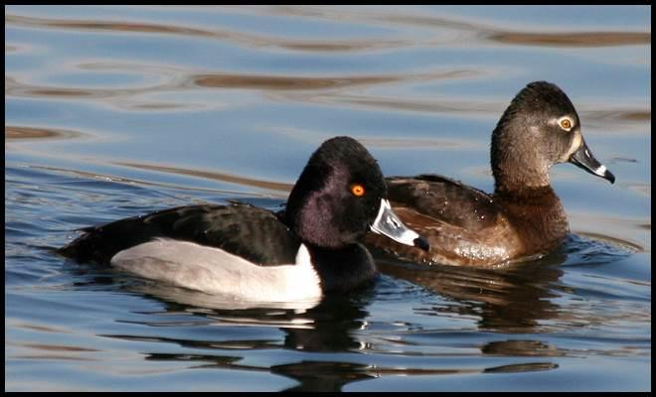
6
Notes:
Ring Necked Duck (male and female)

Slide 29
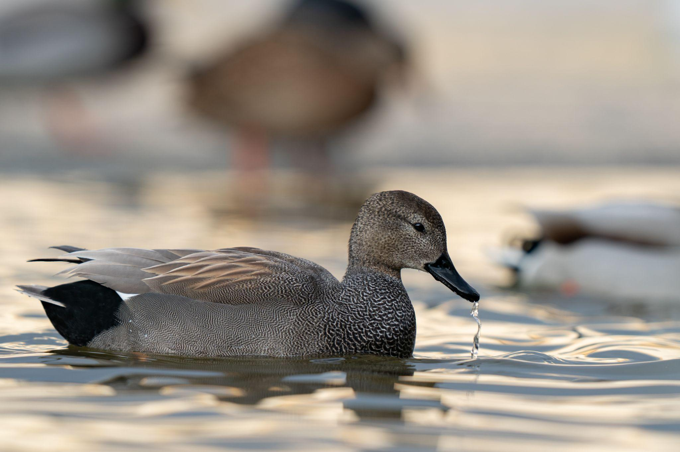
7
Notes:
Gadwall (male)

Slide 30
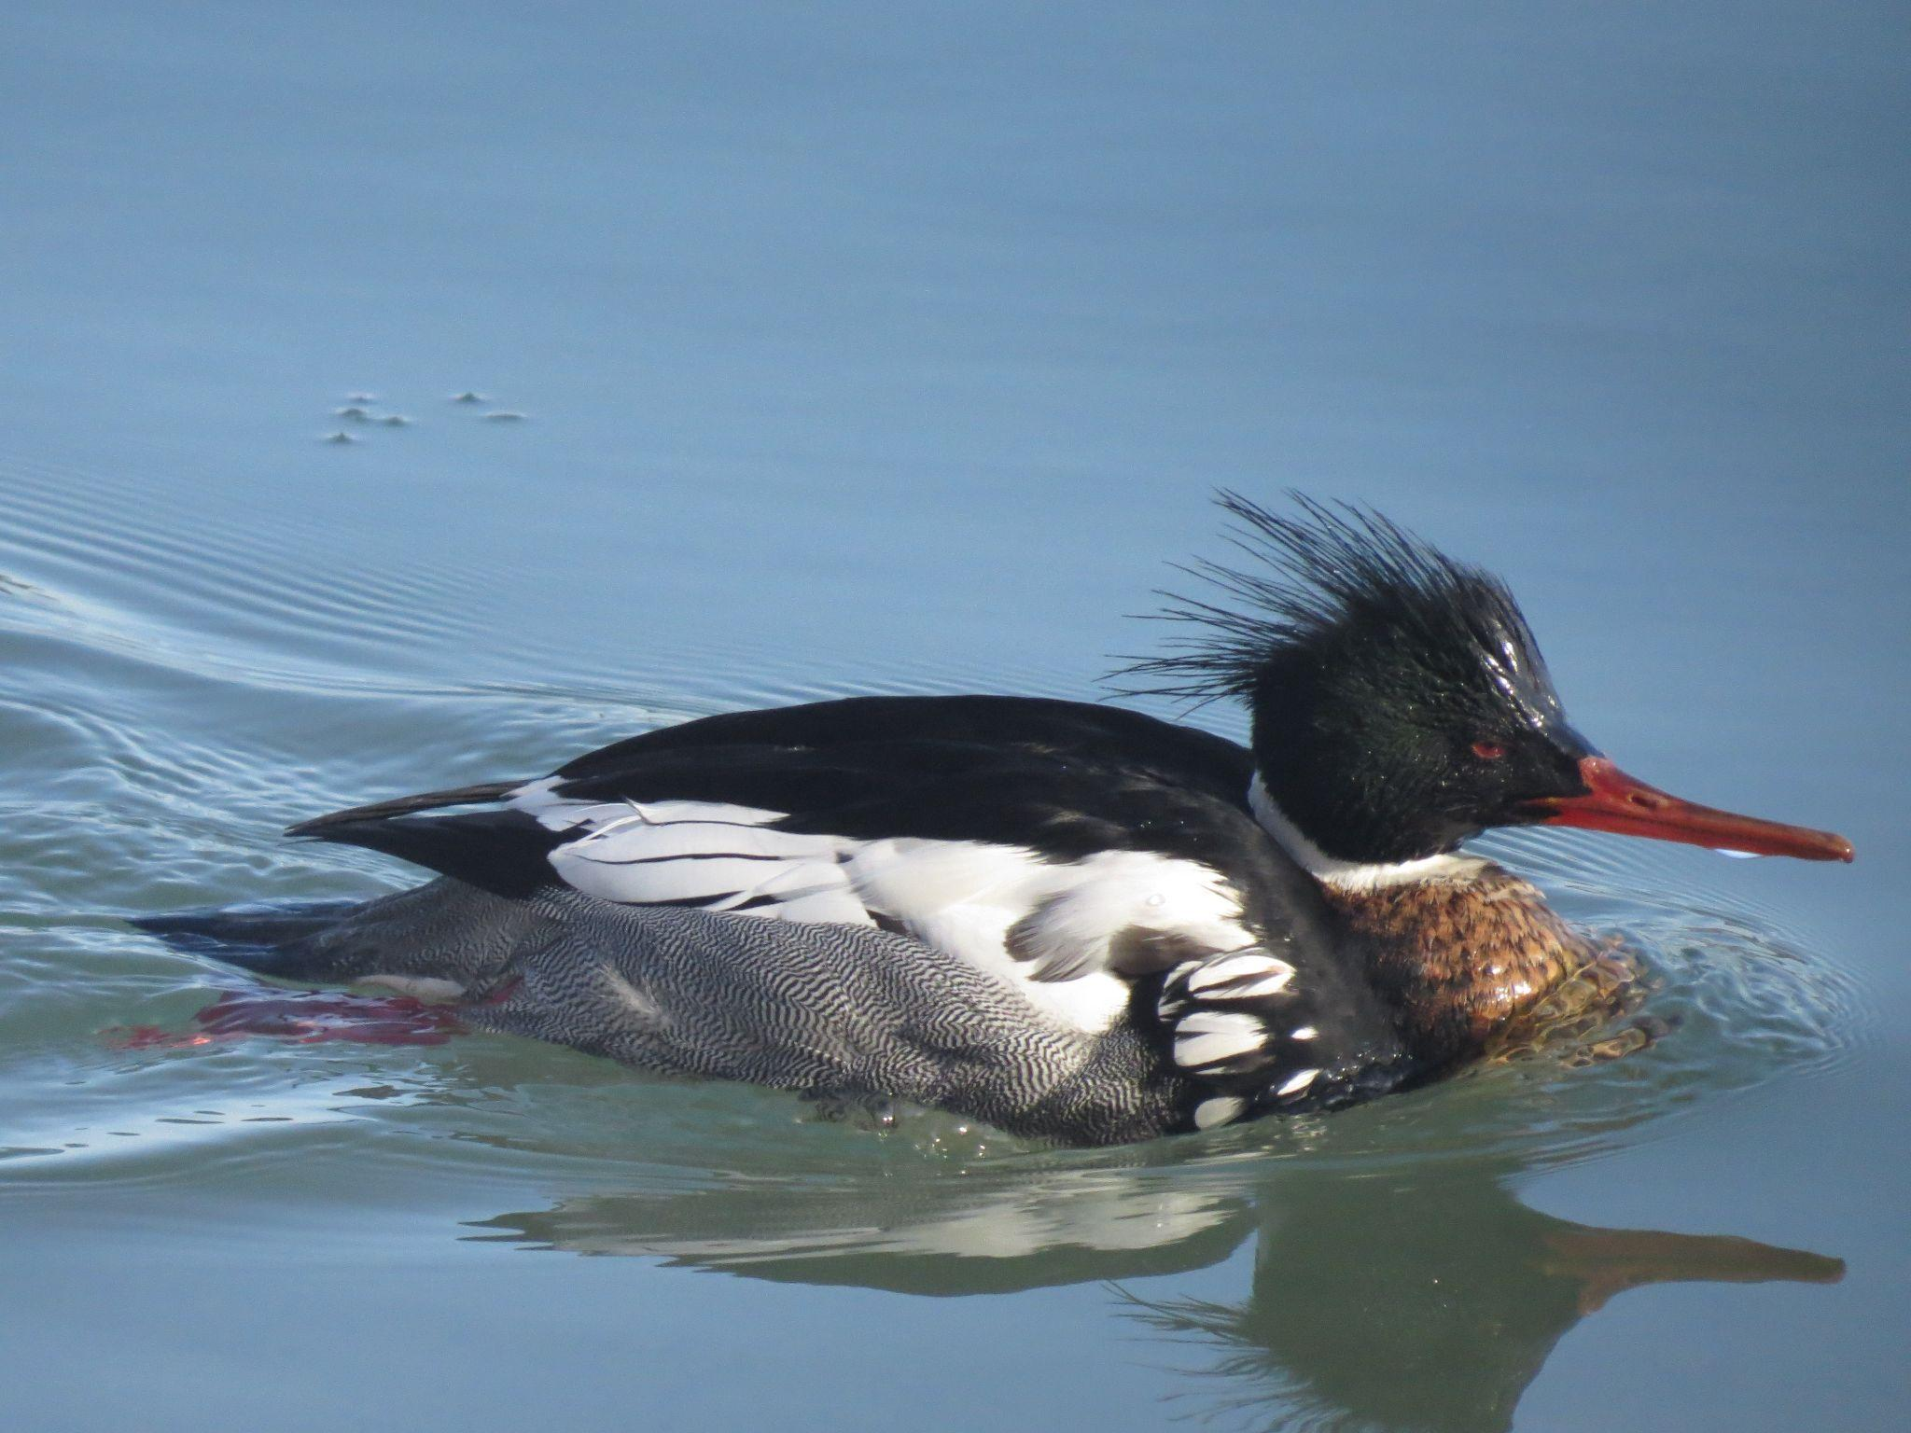
8
Notes:
Red-breasted Merganser (male)

Slide 31
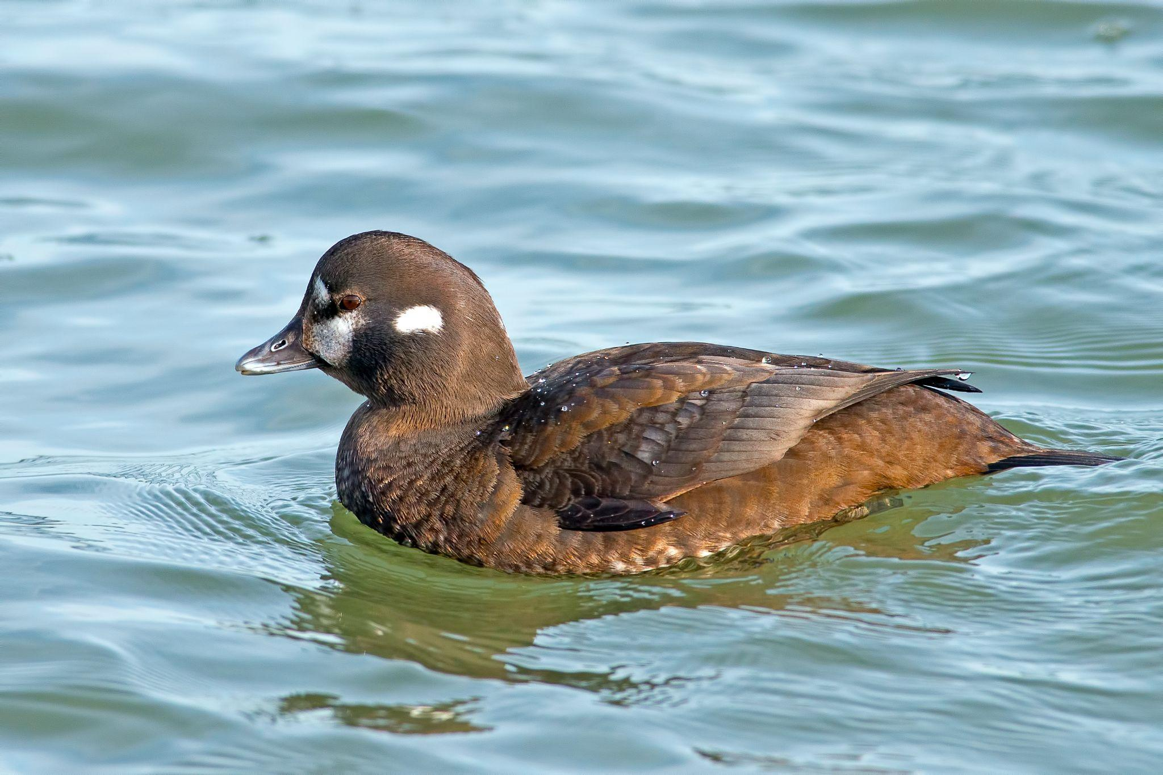
9
Notes:
Harlequin (female)

Slide 32
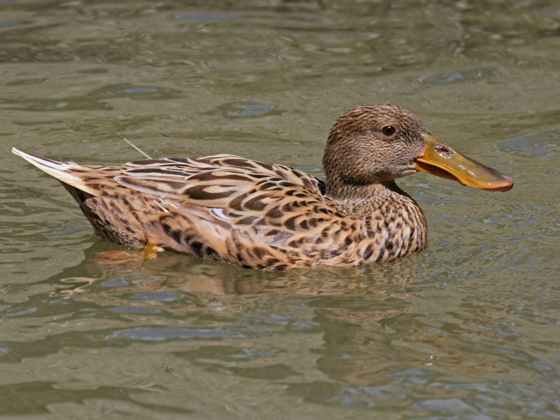
10
Notes:
Northern Shoveler (female)

